Slide 1
Inspection & Audit
Dhirendra Pratap Singh,
Chief Manager, IMAGE
Notes:
© Copyright PresentationGO.com – The free PowerPoint and Google Slides template library

Slide 2
Regulatory Reference:
A robust framework / guideline is the requirement set out by the Reserve Bank of India –
Risk Based Internal Audit,
Concurrent Audit,
IS Audit and
Offsite Monitoring Cell (OMC)

Slide 3
Purpose
Undertakes an independent risk assessment
Formulating the risk-based audit plan
Monitoring the inherent risks of the business activity
Independently evaluates the adequacy, completeness, operational effectiveness and efficiency of the control systems within the organization
Precise scope of risk-based internal audit would be determined for low, medium, high, very high and extremely high-risk areas.
Notes:
© Copyright PresentationGO.com – The free PowerPoint and Google Slides template library

Slide 4
Scope of RBIA
Evaluating the effectiveness of the internal control systems and monitor its application.
Reviewing the adequacy of the risk management procedures and methodologies and take up with the processes for improvement.
Checking the efficiency of routine operations of the bank.
Evaluating the reliability and accuracy of the financial records and reports.
Reviewing the management information system and the efficiency of the electronic banking services.
Implementation of policies and procedures and ensure its effectiveness.
Ensuring that the procedures comply with the legal and regulatory requirements.
Undertaking of fraud investigations, if required.
Evaluating the adequacy of procedures to safeguard the bank’s assets.
Notes:
© Copyright PresentationGO.com – The free PowerPoint and Google Slides template library

Slide 5
Organisational Structure
Hierarchy
ACB
ACE
I&A
ZACE
Notes:
© Copyright PresentationGO.com – The free PowerPoint and Google Slides template library

Slide 6
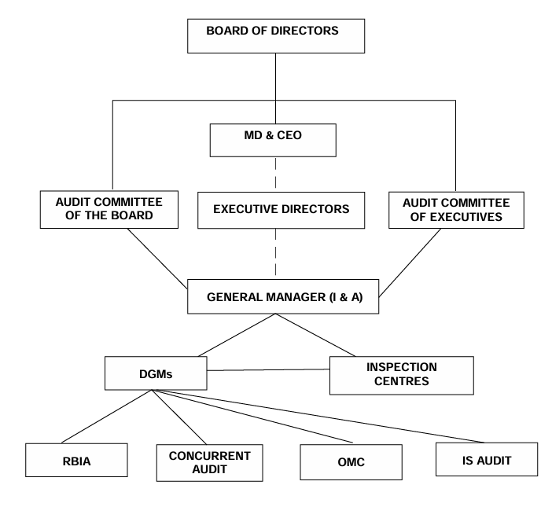
Organizational Structure
Notes:
© Copyright PresentationGO.com – The free PowerPoint and Google Slides template library

Slide 7
ZACE Structure:
IC Head (Chairman)
ZM (Attendance Compulsory)
DZM
Officer of I&A of ZO
Other officials of IC
Invitees: Executive for CO: Insp
Frequency: Monthly
FGMACE Structure:
FGM (Chairman)
IC Head
DGM/2nd in Command of FGM
DZM
Officer of I&A of ZO
Other officials of IC
Invitees: Executive for CO: Insp
Frequency:- Quarterly
Notes:
© Copyright PresentationGO.com – The free PowerPoint and Google Slides template library

Slide 8
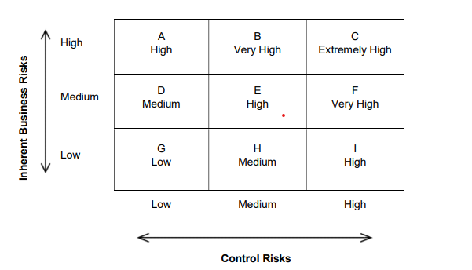
Rating Matrix
Notes:
© Copyright PresentationGO.com – The free PowerPoint and Google Slides template library

Slide 9
Zero Tolerance Area
Notes:
© Copyright PresentationGO.com – The free PowerPoint and Google Slides template library

Slide 10
7.1 i. Non creation of EM / MOD – Branch to be rated as High Risk if :
  Mortgage is pending for any account having Limit of Rs. 50.00 lakhs and above.
  Number of accounts pending for mortgage creation is more than 5 % of the total eligible number of accounts of the Branch, where mortgage is to be created during the relevant audit period.
ii. CERSAI complied for all accounts - Branch to be rated as High Risk if : Accounts pending for CERSAI registration in a Branch are more than 10 numbers.
iii. Non availability of Legal Opinion – Branch to be rated as High Risk if : Legal opinion is not available in any eligible account in a branch having limit of Rs. 10.00 Lakhs and above.
7.2. Creation of charge over securities (Lien of deposit receipts, Assignments & ROC registration) - Branch to be rated as High Risk if :
  i. Creation of Charge /ROC Registration is pending for any account with limit of Rs.50.00 lakhs and above.
  Number of accounts pending for Creation of Charge / ROC Registration is more than 5% of the total eligible accounts of the Branch.
7.3. Sanction exceeding Branch Manager’s discretionary powers: Branch will be treated as High Risk if there is any violation in exercise of discretionary powers.
7.4. End use not ensured, Pre /Post sanction visits of units / Mortgaged Properties not done, discrepancies of Legal Audit not rectified : Branch will be treated as Medium Risk if the number of fresh sanctioned accounts during the review period pending for non compliance of mentioned ZTAs are more than 5 % of the total number of advances of the Branch.

Slide 11
7.5. Incidents of frauds. A branch will be classified as ‘High Risk’ on confirmation of classification of an incident in the branch as fraud by CO: Fraud Risk Management Cell, even though the branch has obtained a better rating as per the latest RBIA if:
  i. Weaknesses in internal controls in the branch have facilitated or led to the incident or there are sufficient reasons to show involvement of internal factors in such fraudulent incident,
  More than three instances of frauds are reported in the branch during a financial year or
  Aggregate fraud amount is more than Rs.10.00 lakh.
  The Incidence of Fraud happened prior to 3 years but classified presently should not be considered to downgrade the risk rating of Branch.
  In case of Consortium / Multiple Banking Account, if the borrower has been declared as fraud observed by other Banks and if there is no fraud element in the accounts with respect to operations in our Bank, the risk rating need not be downgraded for reason of Fraud.
7.6. Special Reports if any pending for Closure.
7.7. Non Reconciliation of Impersonal Heads of accounts, Manual debit in BGL heads like interest, commission and operations in inoperative accounts not as per guidelines will make the branch rated as High Risk.
7.8. Time Barred Documents : i. High - If any account having limit Rs 50.00 lakhs and above is Time Barred. ii. Medium - Number of accounts time barred are more than 5 % of the total number of accounts of the Branch but, all such cases of less than Rs.50.00 lakhs.

Slide 12
7.9. Incomplete /Blank documents, Required stamp duty not paid and Documents not properly maintained ,Special attention to be given by the Inspector to ensure 100% Spot rectification.
  If the spot rectification is not done, Branch to be rated High Risk if :
  Spot rectification pending for any account with sanctioned limit of Rs.50.00 lakhs and above.
  Number of accounts pending for rectification are more than 5 % of the total number of outstanding accounts of the Branch.
7.10. i. Non compliance of KYC norms / Due-diligence for loan and deposit accounts, Non availability of Photo and address proof with authentication.
  ii. Non availability of Verification of genuineness of financial documents on which credit limits are assessed and approved.
  iii. Address confirmation for issuance of cheque books not available.
  For All the Above :
  Special attention to be given by the Inspector to ensure 100% Spot rectification.
  If the spot rectification is not done, Branch to be rated High Risk if :
    I. Spot rectification pending for any account having sanctioned limit of Rs.50.00 lakhs and above.
    II. Number of accounts pending for rectification are more than 5 % of the total number of accounts of the Branch.

Slide 13
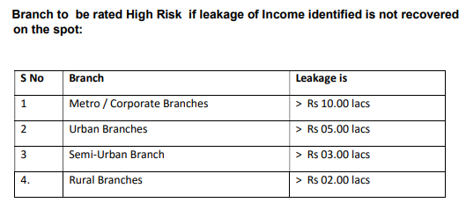
7.11. Reference to CIBIL /RBI defaulter list /SAL/ ECGC restricted list not made before sanctioning the loan. Non availability of such records taken, scrutinized and kept in the file : Branch to be rated as Medium Risk if: Number of accounts pending for rectification are more than 5 % of the total number of accounts of the Branch.
7.12. Revenue leakages, if any, identified by the Concurrent Auditor / Revenue Auditor/HO Inspector/ZO Officials not recovered or duly recommended for waiver if eligible:- Branch to be rated High Risk if leakage of Income identified is not recovered on the spot:
7.13 Non submission of Stock statements in time : Branch to be rated High Risk if:
i. Submission of stock statement is pending for any account having sanctioned limit of Rs.50.00 lakhs and above.
ii. Number of accounts pending for submission of stock statements for more than 3 months are more than 5 % of the total number of accounts in the Branch

Slide 14
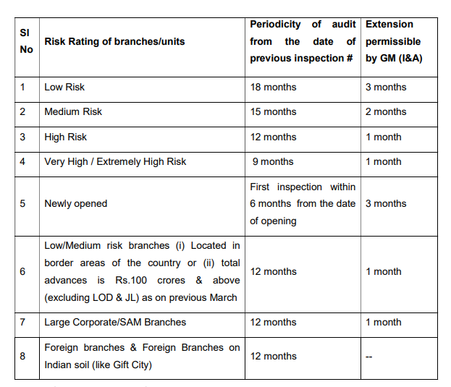
Periodicity of Audit :-

Slide 15
Coverage of RBIA
All loan accounts sanctioned/ renewed/ restructured/ disbursed from the date of last inspection/ RBIA to the date of present RBIA.
Top 100 Borrowal accounts.
All Staff/ Staff related loans
Loan accounts where serious/critical irregularities viz., Incomplete security
documents, defective / imperfect mortgage, dilution of security, diversion of fund,
transgression of discretionary authority, non-compliance of terms of sanction, etc. were
pointed out in the last RBIA/ Inspection Report/Special reports but not yet rectified
All standard loan accounts above Rs 10.00 lakhs sanctioned/ disbursed/
renewed/restructured five years prior to the date of inspection. As per Staff
Accountability Policy, irregularities mentioned during Inspection during the last
four years or two Audit cycles will be the basis for the Staff Accountability study.
Hence all accounts sanctioned during the last five years will be covered during
the regular Inspection.
Notes:
© Copyright PresentationGO.com – The free PowerPoint and Google Slides template library

Slide 16
Other Audits
Notes:
© Copyright PresentationGO.com – The free PowerPoint and Google Slides template library

Slide 17
Snap Audit
Snap audit covers select branches with specific reference to house-keeping problems. Respective IC Head may take a decision for Snap Audit of Branches based on the serious nature of the findings in the Inspection reports / based on the views of Zonal Office/ the level of compliance/ the level of rectification of irregularities/ on occurrence of a fraud.
Such audit may not exceed 3 days. Satisfactory compliance by Branch/ZO shall be discussed in ZACE and accepted for closure.
Notes:
© Copyright PresentationGO.com – The free PowerPoint and Google Slides template library

Slide 18
Revenue Audit/Expenditure Audit
This type of audit is conducted with a view to verify the accuracy, relevance of expenditure incurred & incomes earned by the Bank according to laid down guidelines.
  TOP 100 branches business-wise as on previous March/September will be subjected to Income Expenditure audit by Inspection Centres.
  All branches having total business of Rs.10.00 Crore and above are subjected to Income/Expenditure audit by Zonal Offices
  For branches having total business of less than Rs.10.00 Crore, such exercise shall be carried out along with regular inspection of the branch.
Notes:
© Copyright PresentationGO.com – The free PowerPoint and Google Slides template library

Slide 19
Compliance Audit
Inspection Centres shall carry out compliance audit on monthly basis for all High risk branches and 10% of Medium risk Branches where RBIA file closure has been done in the particular month.
During Compliance Audit, Inspector shall verify all the compliances related to ZTA observations and compliances of minimum 15% of remaining observations (excluding Spot Rectified observations) in RBIA.
Notes:
© Copyright PresentationGO.com – The free PowerPoint and Google Slides template library

Slide 20
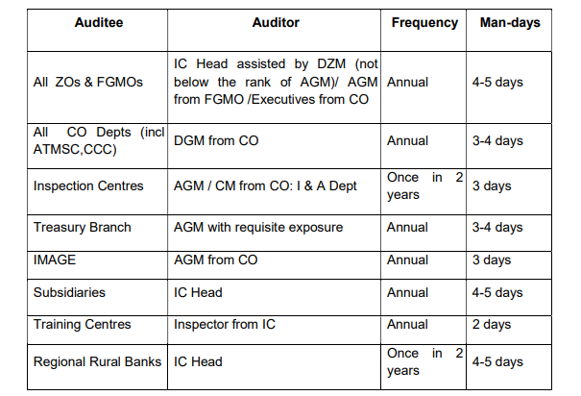
Management Audit
Under Management Audit, the inspector examines the efficacy of management, evaluate and report on the adequacy and reliability of the existing systems to ensure that laws, regulations, internal policies and procedures are meticulously followed and the work is carried out as per delegation of power, defined procedures and Corporate Office guidelines to reach organizational goals
Notes:
© Copyright PresentationGO.com – The free PowerPoint and Google Slides template library

Slide 21
Sustainability Audit
Confirmatory and validating audit of the Bank's adherence to MANC, RMP, RAR, observations of RBI and other significant regulatory requirements to ensure sustainability.
Surprise Inspection
Through the officials from the ICs & RICs, on various operational aspects of the Branch with emphasis on verification of transactions in staff accounts including the verification of any pattern of regular debit / credit in staff account for speculative purposes like trading of shares, online gaming, etc.
Notes:
© Copyright PresentationGO.com – The free PowerPoint and Google Slides template library

Slide 22
Thematic Audit
Thematic Audit on compliance of KYC/AML guidelines shall be conducted in 3 branches per IC per month, covering the following areas:
Awareness of KYC norms among Staff Members/Public
Obtention and verification of KYC documents
Status of uploading KYC documents to Central KYC Registry by Branch
Opening of CIF/Account appropriate to the entity
Creation/ Updation of customer risk categorization/ fixation of threshold limits
De-duplication of personal CIF/ Identification of beneficial owner
Cash transactions in BGL accounts and issue of DD against cash as per AML guidelines
Reports are to be submitted to Branch, ZO, IC and CO: KYC/AML Department. Based on the thematic audit reports, the deficiencies shall be taken up by respective ZO for rectification and compliance and placing the same in ZACE for closure. Quarterly note on implementation of KYC/AML guidelines is submitted to ACE/ACB by CO:KYC/AML Department.
Notes:
© Copyright PresentationGO.com – The free PowerPoint and Google Slides template library

Slide 23
Concurrent Audit
First / Last Name
(123) 456-7890
Your Company
Notes:
© Copyright PresentationGO.com – The free PowerPoint and Google Slides template library

Slide 24
Coverage:- At least 70% of aggregate advances and other risk exposure of the Bank should be covered under concurrent audit on an on-going basis.
Coverage of Branches:-
All Forex authorized branches.
All branches attached with Currency Chest (to comply with the directions of RBI on verification of Currency Chest Transactions and balances by Concurrent Auditors of Banks).
All branches with advance (other than LOD, JL, Food credit & NPA accounts) level as of MARCH of the year above Rs..40 crores.
CO: Departments like Treasury, SWIFT Centre, FXCPC, ATM Service Centre, Credit Card Centre, HRM, Stationery and Premises & Expenditure Departments.
All High risk branches, in which total advance of the branch is above Rs.25 Crores (excluding JL, LOD, Food credit & NPA accounts) as on March of the year.
Foreign Branches & Foreign Branches on Indian soil (like Gift City) are also subjected to Concurrent Audit. Approval for assignment of Concurrent auditors for these branches vests with MD & CEO.
All Central Processing Units viz. RAPC, MAPC, CAPC, CPPC, GBSB, Service Branches, Deva Centre, RTGS/NEFT Cell, DAMCs etc are covered under concurrent audit.
Notes:
© Copyright PresentationGO.com – The free PowerPoint and Google Slides template library

Slide 25
Areas of Coverage
Cash transactions including physical verification of cash, etc
Loans & Advances including physical verification of securities, delegation of Powers for sanction, Security Charge Creation, end use verification of funds, monitoring of accounts with excess drawings, monitoring of projects, etc.
Adherence to KYC / AML guidelines including monitoring of transactions in accounts, compliance with Foreign Account Tax Compliance Act (FATCA) and Common Reporting Standards (CRS), monitoring of transactions in new accounts / staff accounts, reporting of CTR/STR, etc.
Remittances / Bills for Collection including SWIFT transactions, monitoring of overdue statements (Bills Purchased / Discounted / Negotiated, etc.).
House Keeping including reconciliation of accounts, monitoring of BGL / Parking Accounts, opening of internal accounts, etc.
Non-Fund Based Business
Foreign Exchange Transactions
Conduct of employees, mis-selling of products, etc
Compliance to RBI guidelines and internal Policy guidelines issued from time to time
Monitoring of NPA
General Areas
Notes:
© Copyright PresentationGO.com – The free PowerPoint and Google Slides template library

Slide 26
Appointment of Concurrent Auditor
Committee for Selection
Chartered Accountant
GM- I&A, Corp Credit, Mid Corp, CMC, MSME, COO & Accts
GM- I&A, HRM, DGM (Vig) & CRO
Retired Officer
Cost Accountant
Notes:
© Copyright PresentationGO.com – The free PowerPoint and Google Slides template library

Slide 27
IS Audit
First / Last Name
(123) 456-7890
Your Company
Notes:
© Copyright PresentationGO.com – The free PowerPoint and Google Slides template library

Slide 28
Coverage of IS Audit
IS Audit Policy approved by the Board covers all the Computerised Departments /Offices of the Bank including CBS Project Office / Data Centre, DR Site , Near onsite, Branches under NBC, Foreign Branches & Foreign Branches on Indian soil (like Gift City), Service Branches, ATM Switch /ATM Service Centre, ATMs, Treasury Branch, Credit Card Department, HRM Department, NEFT/ RTGS Cell, Registration Authority (Digital Certificate) IT Security Operations Centre, Information Systems Security Department etc. and any other new information technologies to be implemented by the Bank from time to time. In short, it includes all the activities/areas of the organization, where IT systems are used for business purpose.

Slide 29
Objective
Review of the Safeguarding Information Systems Assets / Resources and IT Processes
Verification of Data integrity, availability & confidentiality and Security
Evaluation of System effectiveness and efficiency
Verification of compliance to internal guidelines & procedures in addition to legal, regulatory and statutory requirements

Slide 30
Audit by External IS Auditors:- The following offices shall be subjected to Annual Audit, by External IS Audit firm:
Data Centre, Disaster Recovery Site of CBS & Near Onsite
CBS Project Office, including In-house Software Development.
All e-banking channels (web based and mobile based) like Net Banking, Mobile Banking, UPI etc.
Specialized branches like Service Branch, Treasury Branch etc.
CO: HRM Department, International Division
ATM Switch / Service Centre / Card Issue
IT-SOC (Security Operation Centre)
Information Security Department
NEFT / RTGS Cell etc.
CO: AML Cell
CPPC/CDPC/CAPC/DeVA
Credit Card Department
. Financial Inclusion
Management Information System
Registration authority (RA) Digital certificate

Slide 31
TRANSACTION TESTING
Transaction testing shall be done in respect of release of limits for advances sanctioned / reviewed or renewed with enhancement, from the date of previous audit to the current one.
If the risk rating during the last audit of a particular segment is High -- 50% for that particular segment.
ii. If the overall rating of the branch in previous audit is
  High -- 50%
  Medium& increasing -- 50%
  Medium and decreasing or stable -- 40%
  Low -- 20

Slide 32


