Slide 1
NPA Management POLICY
Ashish Goel
CM-Faculty
IMAGE

Slide 2
Major Modifications in NPA Management Policy
Mechanism for Identification & Classification of WFD
Penal Measures of WFD
Reporting of WFD to CICs
Treatment of Compromise & defaulted loans sold to ARCs
Guiding principals in OTS
Competent Authority for engagement of IRP/RP/Liquidator & approval of professional fee
Asset classification of NPAs based on security

Slide 3
Contents
Why is NPA Recovery Important?
Various Tools & Strategies of recovery
Understanding through MCQs
References Material

Slide 4
Why is NPA recovery important?
Because an NPA account-
Stops earning income to the bank
Directly impacts profitability
Bank has to make huge provisions out of the income earned by other performing assets
Huge expenditure incurred in recovery
Legal issues

Slide 5
What are the tools & strategies used by the bank for recovery?
Upgradation
Re-phasement & restructuring/ rehabilitation
SARFAESI action
Suit filing
Compromise settlement
Lok-adalats
CIRP/ PIRP
PPIRP (pre-packaged insolvency resolution process)
NCB
WFD
Fraud examination
Look out circular

Slide 6
What is required before considering an OTS (One-Time Settlement)?
  A) At least one SARFAESI auction of eligible mortgaged properties should be attempted.
  B) The proposed OTS amount should be below Notional Dues.
  C) The decision on OTS proposals should be taken by the same authority.
  D) The OTS offer should be less than Book Balance and RSV.
Answer: A) At least one SARFAESI auction of eligible mortgaged properties should be attempted.

Slide 7
Who will take the decision on waiver/acceptance of OTS proposals if the waiver amount falls within ZLCC?
  A) FGMCAC
  B) COLCC(GM)
  C) SAM Br.
  D) COLCC(ED)
Answer: A) FGMCAC

Slide 8
According to RBI guidelines, what factors are considered for the classification of NPAs?
  A) Time lag between an account becoming doubtful of recovery
  B) Availability, valuation, and realisation of security
  C) Erosion over time in the value of security charged to the Bank
  D) All of the above
Answer: D) All of the above

Slide 9
Who is the Chairperson of the CGM Committee for asset classification of NPAs?
  A) CGM (R&L)
  B) GM/DH (Accounts)/CFO
  C) Senior most CGM
  D) GM/DH (Recovery-I)
Answer: C) Senior most CGM

Slide 10
What is the quorum required for the CGM Committee to assess the availability, realisation, and erosion of value of security in any account/class of accounts?
  A) 2 members including Chairperson
  B) 3 members including Chairperson
  C) 4 members including Chairperson
  D) 5 members including Chairperson
Answer: B) 3 members including Chairperson

Slide 11
What happens if the Identification Committee is not satisfied with the reasons for wilful default?
  A) The process of wilful default will be dropped in the account.
  B) A show-cause notice will be issued.
  C) The proposal will be forwarded to the Review Committee.
  D) The borrower will be classified as a wilful defaulter.
Answer: A) The process of wilful default will be dropped in the account.

Slide 12
What is the time frame given to the borrower/guarantor to submit their response to the show-cause notice in case of WFD Identification process?
  A) 15 days
  B) 21 days
  C) 30 days
  D) 45 days
Answer: B) 21 days

Slide 13
What action is taken if no representation is received from the borrower/guarantor within the stipulated time of 21 days?
  A) The process will be dropped.
  B) The borrower will be classified as a wilful defaulter.
  C) The proposal will be forwarded to the Review Committee.
  D) The borrower will be given another chance to respond.
Answer: C) The proposal will be forwarded to the Review Committee.

Slide 14
What should be the first appropriation of any recovery in NPA accounts?
  A) Unpaid Legal Expenses (MLE)
  B) Unpaid Other Expenses (MOX)
  C) Book Balance (Principal)
  D) Unpaid Interest (MOI)
Answer: C) Book Balance (Principal)

Slide 15
For how long is the bar on additional credit facility to a wilful defaulter or any associated entity effective after the name is removed from the List of Wilful Defaulters (LWD)?
  A) 6 months
  B) 1 year
  C) 3 years
  D) 5 years
Answer: B) 1 year

Slide 16
What is the period during which no credit facility shall be granted for floating new ventures to a wilful defaulter or any associated entity after the name is removed from the LWD?
  A) 1 year
  B) 3 years
  C) 5 years
  D) 7 years
Answer: C) 5 years

Slide 17
What is required for secured creditors to exercise the power of enforcement of securities under SARFAESI Act?
  A) Consent from 30% in value of the amount outstanding
  B) Consent from 50% in value of the amount outstanding
  C) Consent from 60% in value of the amount outstanding
  D) Consent from 70% in value of the amount outstanding
Answer: C) Consent from 60% in value of the amount outstanding

Slide 18
What action should the bank take against borrowers/guarantors for recovery of dues in case of wilful default?
  A) Grant additional credit facilities
  B) Initiate criminal proceedings and foreclosure
  C) Restructure the credit facility
  D) Remove the name from the LWD without any further action
Answer: B) Initiate criminal proceedings and foreclosure

Slide 19
What action should branches take if repayments are not forthcoming as per OTS sanction terms?
  A) Communicate the cancellation of OTS
  B) Proceed with legal action
  C) Initiate action under SARFAESI Act
  D) All of the above
Answer: D) All of the above

Slide 20
What is the primary aim of the Bank once an account becomes NPA?
  A) To file a suit at DRT
  B) To conduct a forensic audit
  C) To regularize the account by recovering critical amounts
  D) To initiate personal insolvency
Answer: C) To regularize the account by recovering critical amounts

Slide 21
Which of the following is considered as cash recovery in NPA accounts?
  A) Recovery from sale of charged assets through DRT/Court
  B) Recovery from sale of assets to ARCs/ASCs/Banks on cash basis
  C) Recovery in compromise settled accounts
  D) All of the above
Answer: D) All of the above

Slide 22
What does a compromise settlement entail?
  A) Full recovery of dues without any sacrifice
  B) A negotiated arrangement with possible sacrifice of the amount due
  C) Immediate repayment of the entire loan amount
  D) No involvement of the borrower
Answer: B) A negotiated arrangement with possible sacrifice of the amount due

Slide 23
What is the cooling period for Non-Farm Credit after a compromise settlement?
  A) 6 months
  B) 12 months
  C) 18 months
  D) 24 months
Answer: D) 24 months

Slide 24
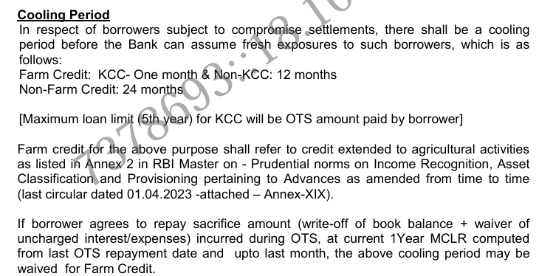

Slide 25
What should be done before considering an OTS?
  A) Conduct a forensic audit
  B) Attempt at least one SARFAESI auction
  C) File a suit at DRT
  D) Initiate personal insolvency
Answer: B) Attempt at least one SARFAESI auction

Slide 26
What is the primary objective of determining the Reference Recoverable Amount (RRA)?
  A) To minimize recovery and maximize sacrifice
  B) To maximize recovery and minimize sacrifice
  C) To equalize recovery and sacrifice
  D) To ignore recovery and focus on sacrifice
Answer: B) To maximize recovery and minimize sacrifice

Slide 27
What is the minimum upfront amount required for OTS proposals of Rs.10.00 lakhs and above?
  A) 5% of the OTS offered
  B) 10% of the OTS offered
  C) 15% of the OTS offered
  D) 20% of the OTS offered
Answer: B) 10% of the OTS offered

Slide 28
What should be included in the compromise proposal for accounts with identified staff lapses?
  A) Status of staff accountability examination
  B) Details of the borrower's financial statements
  C) Valuation reports of charged securities
  D) All of the above
Answer: A) Status of staff accountability examination

Slide 29
What is the Net Present Value (NPV) of securities?
  A) The future value of the amount that may be recovered
  B) The present value of the amount that may be recovered at a future date
  C) The total dues of the borrower
  D) The book balance of the borrower's account
Answer: B) The present value of the amount that may be recovered at a future date

Slide 30
What is the maximum age of valuation reports for securities in NPA accounts when considering Compromise Settlements?
  A) 6 months
  B) 1 year
  C) 2 years
  D) 3 years
Answer: B) 1 year

Slide 31
Who should certify the realizable value of stocks and book debts for values up to Rs.100 lakhs?
  A) Approved valuer
  B) Branch Manager
  C) External auditor
  D) Government authority
Answer: B) Branch Manager

Slide 32
What is the cost of realization deducted from the Realisable Value to calculate NPV?
  A) 5% of RV
  B) 10% of RV
  C) 15% of RV
  D) 20% of RV
Answer: B) 10% of RV

Slide 33
What percentage of the assessed value of agricultural land is taken as the realizable value for computing NPV?
  A) 50%
  B) 75%
  C) 85%
  D) 100%
Answer: C) 85%

Slide 34
What is the discount rate applied for calculating NPV for FY 24-25?
  A) 7.85%
  B) 8.85%
  C) 9.85%
  D) 10.85%
Answer: B) 8.85%

Slide 35
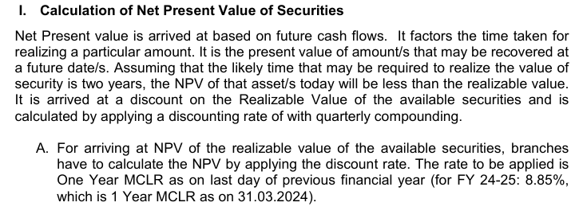

Slide 36
What is the maximum discount period for House/Residential Properties in Metro cities?
  A) 1 year
  B) 2 years
  C) 3 years
  D) 4 years
Answer: B) 2 years

Slide 37
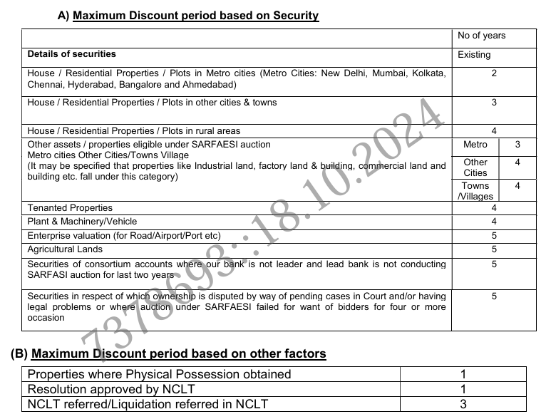

Slide 38
What percentage of the last SARFAESI reserve price is used to cap the NPV of residential/industrial properties?
  A) 50%
  B) 60%
  C) 70%
  D) 80%
Answer: C) 70%

Slide 39
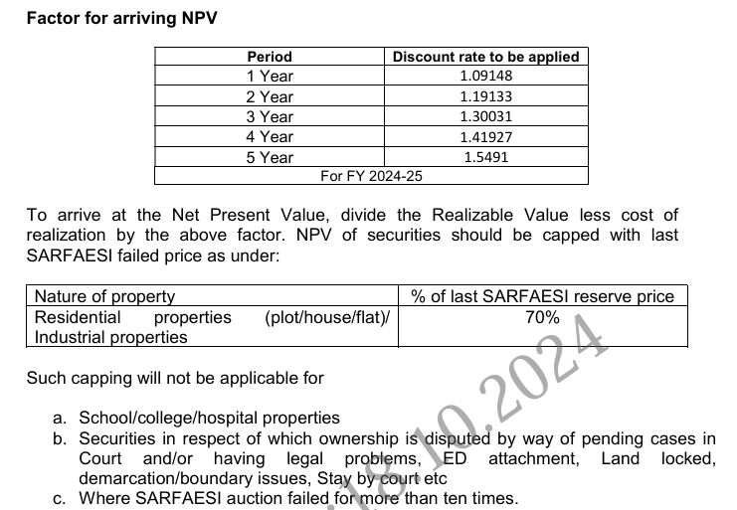

Slide 40
What should the OTS amount generally not be less than, according to RBI directives?
  A) Market Value of securities
  B) Net Present Value (NPV) of realizable value of securities
  C) Distress Sale Value of securities
  D) Book Value of securities
Answer: B) Net Present Value (NPV) of realizable value of securities

Slide 41
What is the definition of a Stuck Project according to the Ministry of Road Transport and Highways (MoRTH)?
  A) A project where work has stopped due to financial issues.
  B) A project where work has stopped due to proceedings initiated under the Insolvency and Bankruptcy Code 2016 or Section 241(2) of the Companies Act 2013.
  C) A project where work has stopped due to default by both parties (NHAI/NHIDCL/State PWD and the contractor/concessionaire).
  D) Both B and C.
Answer: D) Both B and C.

Slide 42
What additional concession is given for unsecured NPA accounts with Real Balance up to Rs.10 lakhs if repayments made by the borrower are more than 50% of the amount availed?
  A) 5% in RRA
  B) 10% in RRA
  C) 15% in RRA
  D) 20% in RRA
Answer: B) 10% in RRA

Slide 43
For NPAs with Real Balance above Rs.1 crore, what is the settlement formula if NPV + Net Worth (NW) is less than ND but more than or equal to RB in the D-01 category?
  A) RB + 70% of INT
  B) RB + 60% of INT
  C) RB + 50% of INT
  D) RB + 30% of INT
Answer: D) RB + 30% of INT

Slide 44
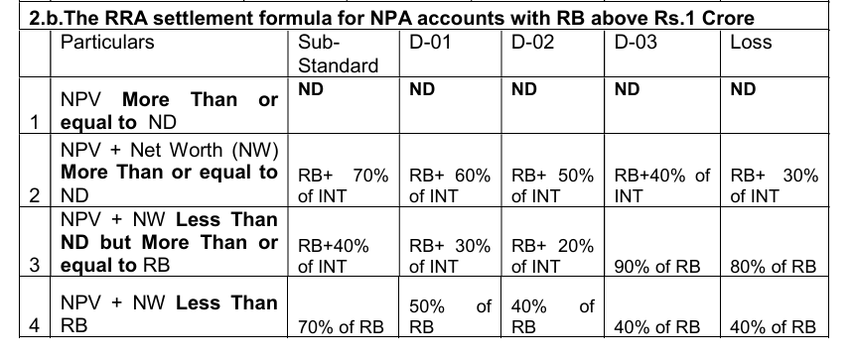

Slide 45
What is the final RRA for NPAs with Real Balance above Rs.10 lakhs?
  A) The higher of NPV or RRA as computed, restricted to Notional Dues.
  B) The lower of NPV or RRA as computed, restricted to Notional Dues.
  C) The total dues owed by the borrower.
  D) The net worth of the borrower and guarantors.
Answer: A) The higher of NPV or RRA as computed, restricted to Notional Dues.

Slide 46
What is the upper limit for the Non-Discretionary and Non-Discriminatory OTS policy?
  A) Rs.50.00 lakhs
  B) Rs.75.00 lakhs
  C) Rs.100.00 lakhs
  D) Rs.150.00 lakhs
Answer: C) Rs.100.00 lakhs

Slide 47
What is the settlement formula for Educational Loans with a limit up to Rs.7.50 lakhs in the Sub-standard category?
  A) 80% of RB
  B) 70% of RB
  C) 60% of RB
  D) 50% of RB
Answer: B) 70% of RB

Slide 48
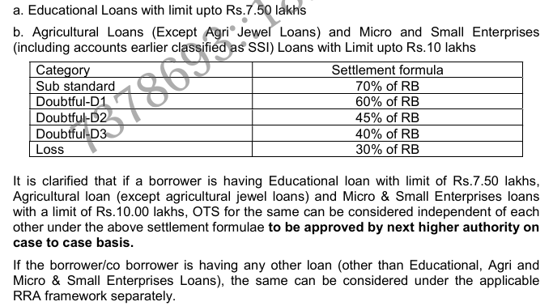

Slide 49
Which of the following cases are not covered under the Non-Discretionary and Non-Discriminatory OTS policy?
  A) OTS settled cases already under repayment
  B) Units under rehabilitation/restructuring
  C) Cases referred to NCLT under Insolvency and Bankruptcy Code (IBC)
  D) All of the above
Answer: D) All of the above

Slide 50
For NPAs with Real Balance less than Rs.10 lakhs or above Rs.1 Crore, which framework will apply?
  A) Special category framework
  B) Regular RRA framework
  C) Discretionary framework
  D) Non-discretionary framework
Answer: B) Regular RRA framework

Slide 51
For NPA accounts with Real Balance up to Rs.10 lakhs, what value should be taken for the net worth of borrower/guarantors in the settlement formula?
  A) Actual net worth
  B) Zero
  C) 50% of net worth
  D) 25% of net worth
Answer: B) Zero

Slide 52
What is the final RRA for NPAs with asset classification D3 or Loss as on 31.03.2024 and minimum 5 years old with Real Balance above Rs.10 lakhs?
  A) NPV or RRA as computed, whichever is lower
  B) NPV or RRA as computed, whichever is higher
  C) Total Dues
  D) Notional Dues
Answer: B) NPV or RRA as computed, whichever is higher

Slide 53
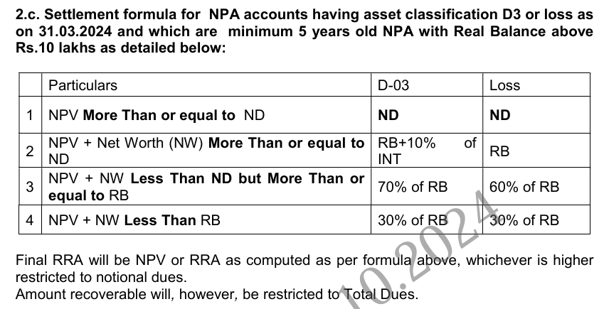

Slide 54
What is the settlement formula for Housing Loan NPA with Real Balance up to Rs.10 lakhs and up to Rs.1 Crore if NPV is less than RB in the Doubtful-02 category?
  A) 80% of RB
  B) 70% of RB
  C) 40% of RB
  D) 30% of RB
Answer: C) 40% of RB

Slide 55
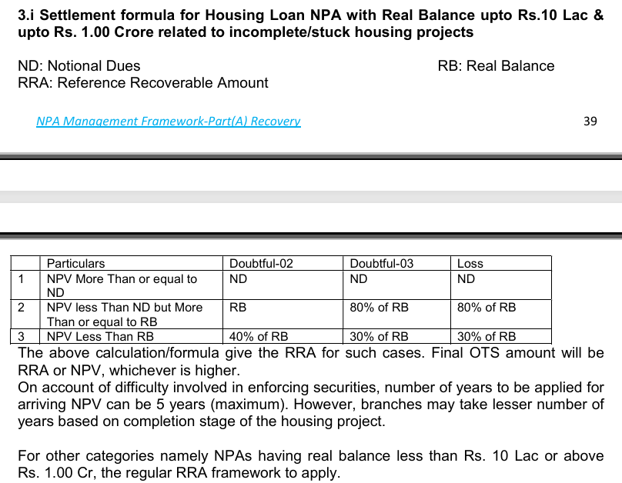

Slide 56
Who is the Chairman of the SAM OTS Committee (SAM-OC)?
  A) Assistant Manager
  B) Branch Head
  C) Senior Officer
  D) Manager
Answer: B) Branch Head

Slide 57
Who can consider OTS cases involving frauds, malfeasance, or wilful default declared?
  A) ZLSCC
  B) FGMCAC
  C) Management Committee of the Board (MCB)
  D) COLCC(GM)
Answer: C) Management Committee of the Board (MCB)

Slide 58
Who approves special schemes of the originator to settle OTS with individual borrowers of Pooled Asset/Co-Lending?
  A) ZLSCC
  B) FGMCAC
  C) Credit Risk Management Committee (CRMC)
  D) COLCC(GM)
Answer: C) Credit Risk Management Committee (CRMC)

Slide 59
Who should not use discretion in respect of loans they previously sanctioned?
  A) Branch Managers
  B) Authorities exercising delegated powers
  C) Committee members
  D) All of the above
Answer: B) Authorities exercising delegated powers

Slide 60
Who is the approval authority for the Bank’s mandate on the Resolution Plan (RP) for all accounts?
  A) ZLCC
  B) FGM(CAC)
  C) COLCC(ED)
  D) CAC
Answer: C) COLCC(ED)

Slide 61
What is the maximum period for payment in installments for OTS?
  A) 6 months
  B) 9 months
  C) 12 months
  D) 18 months
Answer: C) 12 months

Slide 62
What should be included in consent orders for compromise settlements in fraud cases?
  A) A clause stating that the settlement affects ongoing criminal cases
  B) A clause stating that the settlement does not affect ongoing criminal cases
  C) A clause stating that the settlement is final and binding
  D) A clause stating that the settlement is subject to approval by the court
Answer: B) A clause stating that the settlement does not affect ongoing criminal cases

Slide 63
What is the purpose of establishing the Stressed Assets Management Vertical (SAMV)?
  A) To handle new loan applications
  B) To focus on recovery efforts for high-value NPA accounts
  C) To manage customer service inquiries
  D) To oversee branch operations
Answer: B) To focus on recovery efforts for high-value NPA accounts

Slide 64
What is required for outstanding unexpired guarantees in non-fund based facilities?
  A) 50% cash margin
  B) 75% cash margin
  C) 100% cash margin
  D) No cash margin
Answer: C) 100% cash margin

Slide 65
What is the procedure for selling movable securities under the hypothecation agreement outside SARFAESI Act?
  A) Obtaining quotations from parties
  B) Inviting bids from the public
  C) Holding auction/e-auction
  D) All of the above
Answer: D) All of the above

Slide 66
Which NPA accounts need not be transferred to SAM branches?
  A) Accounts with approved and implemented/under implementation restructure/OTS sanctions
  B) Fresh NPA accounts for a period of 1 year or six months
  C) Accounts where operations are permitted by the Competent Authority as per NPA Management Policy
  D) All of the above
Answer: D) All of the above

Slide 67
Who handles NPA accounts with book balance of Rs.1.00 crore and above?
  A) Parent branches
  B) SAM Large Branches
  C) SAM Small Branches
  D) Zonal Offices
Answer: B) SAM Large Branches

Slide 68
When can the Bank participate in auctions for properties charged to the Bank under SARFAESI Act?
  A) After 1 failed auction
  B) After 2 failed auctions
  C) After 3 failed auctions
  D) After 4 failed auctions
Answer: B) After 2 failed auctions

Slide 69
Who is empowered to approve the transfer of accounts to SAM branches as per SOP guidelines?
  A) Branch Manager
  B) Zonal Manager
  C) FGM
  D) MD & CEO
Answer: C) FGM

Slide 70
What is the basic premise of the e-OTS module?
  A) Discretionary Policy
  B) Non-Discretionary and Non-Discriminatory (NDND) Policy
  C) Customer Service Policy
  D) Loan Approval Policy
Answer: B) Non-Discretionary and Non-Discriminatory (NDND) Policy

Slide 71
What should be provided to advocates at the time of filing OA in case of borrower company defaults?
  A) Details of the loan agreement
  B) Details of personal assets of guarantors
  C) Details of the borrower's business operations
  D) Details of the borrower's financial statements
Answer: B) Details of personal assets of guarantors

Slide 72
What is the eligibility criterion for NPA borrowers to use the e-OTS facility?
  A) Real Balance up to Rs.5.00 Lakh
  B) Real Balance up to Rs.10.00 Lakh
  C) Real Balance up to Rs.15.00 Lakh
  D) Real Balance up to Rs.20.00 Lakh
Answer: B) Real Balance up to Rs.10.00 Lakh

Slide 73
What constitutes wilful default by a unit?
  A) Defaulting in meeting payment obligations despite having the capacity to do so
  B) Diverting funds for purposes other than those for which finance was availed
  C) Siphoning off funds
  D) All of the above
Answer: D) All of the above

Slide 74
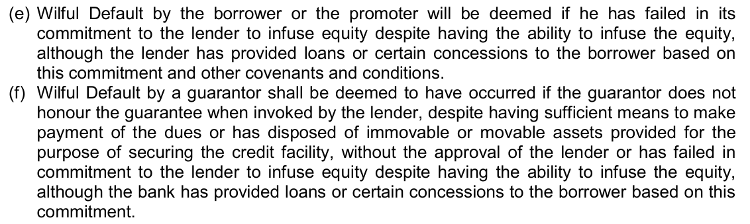

Slide 75
Who is not considered a wilful defaulter unless it is conclusively established that they consented to or were aware of the wilful default?
  A) Whole-time directors
  B) Independent directors
  C) Nominee directors
  D) Both B and C
Answer: D) Both B and C

Slide 76
What is the objective of a forensic audit?
  A) To determine if fraud has occurred
  B) To prove the loss and responsibility
  C) To establish guilt and identify other beneficiaries
  D) All of the above
Answer: D) All of the above

Slide 77
What is the minimum book balance for which a forensic audit is compulsory?
  A) Rs.10.00 crores
  B) Rs.25.00 crores
  C) Rs.50.00 crores
  D) Rs.100.00 crores
Answer: C) Rs.50.00 crores

Slide 78
What does technical write-off refer to?
  A) Writing off non-performing assets for accounting purposes without waiving claims against the borrower
  B) Writing off non-performing assets and waiving all claims against the borrower
  C) Writing off performing assets for accounting purposes
  D) Writing off assets without any accounting purposes
Answer: A) Writing off non-performing assets for accounting purposes without waiving claims against the borrower

Slide 79
What is the goal for annual recovery in written off accounts as directed by GOI, MOF?
  A) 5% of the outstanding amount
  B) 10% of the outstanding amount
  C) 15% of the outstanding amount
  D) 20% of the outstanding amount
Answer: B) 10% of the outstanding amount

Slide 80
Who can exercise the power of waiver of legal action up to the limit of write off powers delegated to them under the OTS Policy?
  A) Branch Managers
  B) Zonal Managers and above
  C) Loan Officers
  D) Recovery Agents
Answer: B) Zonal Managers and above

Slide 81
Which accounts are eligible for allowing operations under the policy on potentially viable NPA accounts?
  A) All NPA accounts under Sub Standard and Doubtful 01 category
  B) Accounts under Doubtful 02 category in exceptional cases
  C) Both A and B
  D) Only accounts under Sub Standard category
Answer: C) Both A and B

Slide 82
What is the quorum requirement for the Asset Sales Committee (ASC)?
  A) Two members
  B) Three members
  C) Four members
  D) Five members
Answer: B) Three members

Slide 83
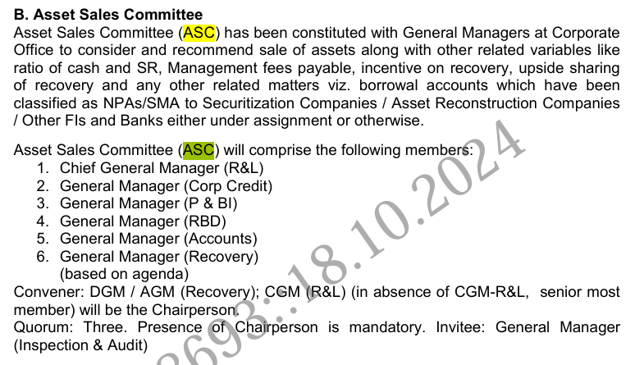

Slide 84
Who is the Chairman of the Settlement Advisory Committee (SAC)?
  A) Retired senior IPS officer
  B) Retired High Court Judge
  C) Retired GM of a Public Sector Bank
  D) General Manager (Recovery)
Answer: B) Retired High Court Judge

Slide 85
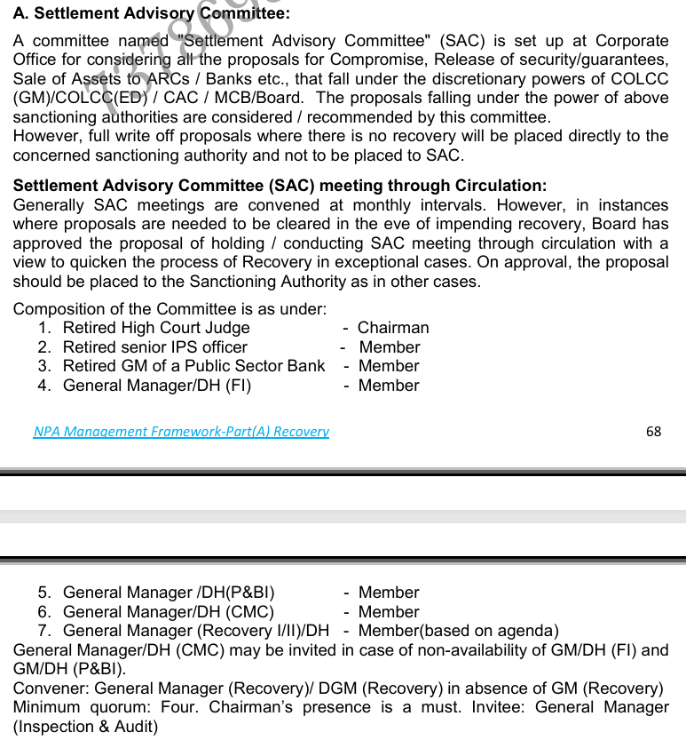

Slide 86
Who is the Chairman of the Wilful Defaulter Review Committee - II?
  A) ED (2nd Senior Most)
  B) ED (Senior Most ED)
  C) MD & CEO
  D) CGM (R&GR)
Answer: B) ED (Senior Most ED)

Slide 87
Which committee examines accounts from the wilful defaulter angle for amounts above Rs 25 Cr?
  A) Wilful Defaulter Identification Committee - I
  B) Wilful Defaulter Identification Committee - II
  C) Wilful Defaulter Identification Committee - III
  D) Wilful Defaulter Review Committee - I
Answer: C) Wilful Defaulter Identification Committee - III

Slide 88
What happens if the post of MD & CEO is vacant for the Wilful Defaulter Review Committee - III?
  A) The committee will not function
  B) The 1st Independent Director will be the Chairman
  C) The ED (Senior Most) will be the Chairman
  D) The committee will be dissolved
Answer: B) The 1st Independent Director will be the Chairman

Slide 89
What is the maximum percentage of operating profit that can be used to create floating provisions in any particular year?
  A) 3%
  B) 5%
  C) 7%
  D) 10%
Answer: B) 5%

Slide 90
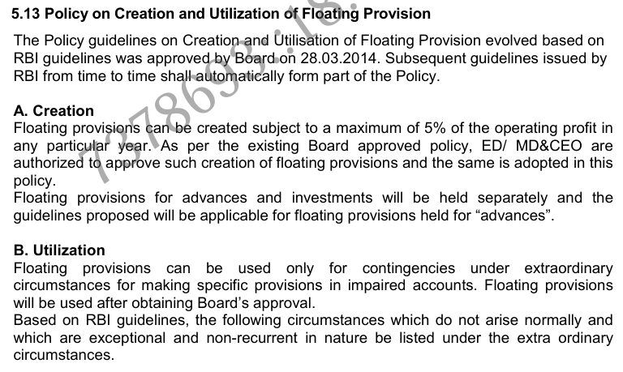

Slide 91
Who is authorized to approve the creation of floating provisions?
  A) Branch Manager
  B) Zonal Manager
  C) ED/MD&CEO
  D) Board of Directors
Answer: C) ED/MD&CEO

Slide 92
Under what circumstances can floating provisions be utilized?
  A) For any operational expenses
  B) Only for contingencies under extraordinary circumstances
  C) For regular loan disbursements
  D) For employee bonuses
Answer: B) Only for contingencies under extraordinary circumstances

Slide 93
Who identifies eligible accounts for sale and recommends them to the Board Level Committee for Monitoring of Recovery?
  A) Branch Manager
  B) Zonal Manager
  C) Asset Sales Committee (ASC)
  D) Recovery Agent
Answer: C) Asset Sales Committee (ASC)

Slide 94
How can floating provisions be treated until they are utilized?
  A) As part of Tier I capital
  B) As part of Tier II capital within the overall ceiling of 1.25% of the total risk-weighted assets
  C) As part of operational expenses
  D) As part of employee benefits
Answer: B) As part of Tier II capital within the overall ceiling of 1.25% of the total risk-weighted assets

Slide 95
What is the maximum net owned funds (NOF) required for ARCs to be eligible for the sale of financial assets from banks as of 01.04.2024?
  A) Rs.100.00 crores
  B) Rs.200.00 crores
  C) Rs.300.00 crores
  D) Rs.400.00 crores
Answer: B) Rs.200.00 crores

Slide 96
What is the basis for the Bank's assessment of the value offered by ARCs/NARCL/Banks/FIs/NBFCs for financial assets?
  A) Market value
  B) Net Book Value and available securities
  C) Historical cost
  D) Replacement cost
Answer: B) Net Book Value and available securities

Slide 97
What should be done if a moratorium order under the Insolvency and Bankruptcy Code 2016 is in operation?
  a) Proceed with filing the suit
  b) Defer suit filing until the moratorium period is over
  c) File the suit in a different court
  d) Ignore the moratorium order
  Answer: b) Defer suit filing until the moratorium period is over

Slide 98
Who has the full discretionary authority for filing suits?
  a) ZLCC (AGM)
  b) ZLCC (DGM)
  c) COLCC (GM)
  d) CAC
Answer: d) CAC

Slide 99
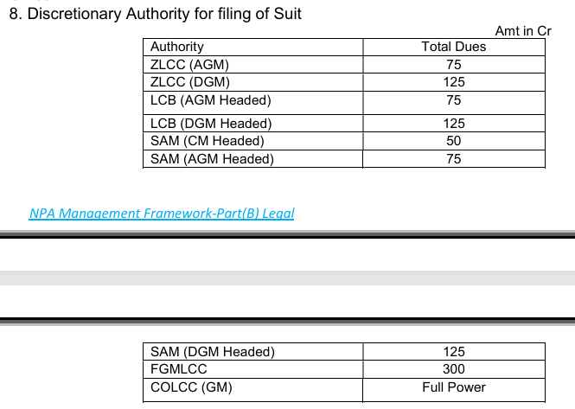

Slide 100
What is the minimum practice experience required for advocates to be empanelled under Category A?
  a) 5 years
  b) 10 years
  c) 15 years
  d) 20 years
  Answer: c) 15 years

Slide 101
What is the minimum score required for advocates to be eligible for an interview for empanelment under Category A & B?
  a) 40%
  b) 50%
  c) 60%
  d) 70%
  Answer: c) 60%

Slide 102
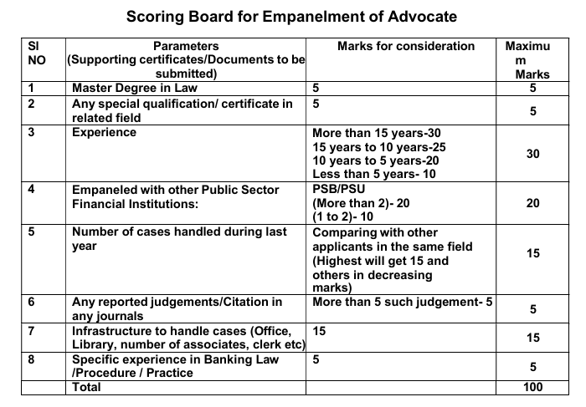

Slide 103
Who is authorized to empanel or remove advocates for zones/branches under their control?
  a) Branch Manager
  b) FGMLCC
  c) Zonal Manager
  d) Chief Financial Officer
  Answer: b) FGMLCC

Slide 104
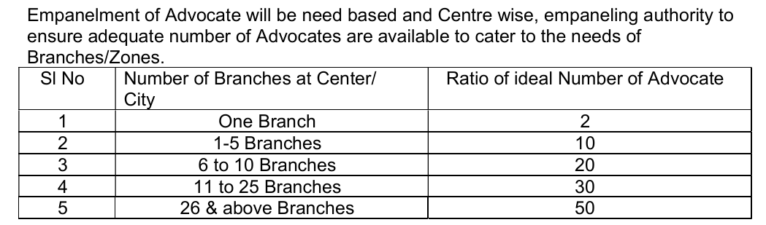

Slide 105
What is the minimum score required for advocates to be eligible for an interview for empanelment under Category A & B?
  a) 40%
  b) 50%
  c) 60%
  d) 70%
  Answer: c) 60%

Slide 106
How many advocates are ideally needed for a center with 6 to 10 branches?
  A) 10
  B) 20
  C) 30
  D) 50
Answer: B) 20

Slide 107
How often will the proposed online portal for advocate empanelment be opened?
  a) Monthly
  b) Quarterly
  c) Biannually
  d) Annually
  Answer: c) Biannually

Slide 108
Which document is NOT required to be obtained from advocates for empanelment?
  a) Bio data
  b) High school certificate
  c) Bank account statement
  d) PAN Card/Aadhar Card
  Answer: c) Bank account statement

Slide 109
Who is empowered to create a panel of Private Detective Agencies (PDAs)?
  A) FGMLCC
  B) ZLCC
  C) COLCC
  D) SEC
Answer: B) ZLCC

Slide 110
How many unsuccessful public auction attempts are required before considering a private treaty sale?
  A) One
  B) Two
  C) Three
  D) Four
Answer: B) Two

Slide 111
What is the reserve price set at for a private treaty sale?
  A) 50% of market value
  B) 70% of distress sale value
  C) 60% of market value or 80% of distress sale value, whichever is higher
  D) 90% of market value
Answer: C) 60% of market value or 80% of distress sale value, whichever is higher

Slide 112
Which tribunal handles insolvency resolution for corporate debtors?
  A) Debts Recovery Tribunals (DRTs)
  B) National Company Law Tribunals (NCLTs)
  C) High Courts
  D) Supreme Court
Answer: B) National Company Law Tribunals (NCLTs)

Slide 113
What is the minimum amount of default required to file an IBC application?
  A) Rs. 1 lakh
  B) Rs. 10 lakhs
  C) Rs. 50 lakhs
  D) Rs. 1 crore
Answer: D) Rs. 1 crore

Slide 114
What percentage of the Committee of Creditors (CoC) voting share is required to approve a resolution plan?
  A) 50%
  B) 66%
  C) 75%
  D) 90%
Answer: B) 66%

Slide 115
What is the maximum fine for contravening IBC provisions, rules, or regulations?
  A) Rs. 50 lakhs
  B) Rs. 1 crore
  C) Rs. 1.5 crores
  D) Rs. 2 crores
Answer: D) Rs. 2 crores

Slide 116
What is the minimum score required for Recovery Agents to be recommended for empanelment?
  A) 30%
  B) 40%
  C) 50%
  D) 60%
Answer: B) 40%

Slide 117
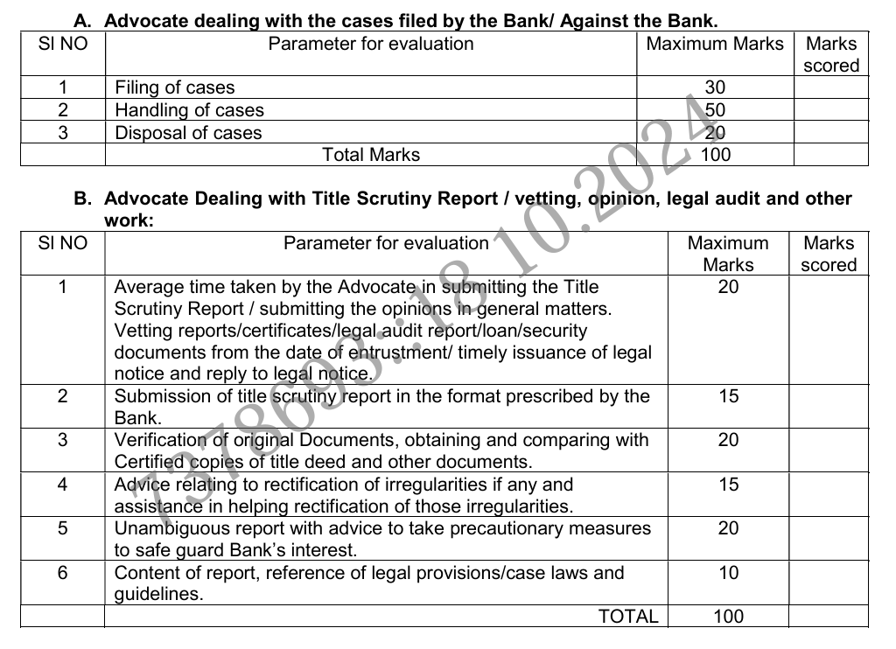

Slide 118
What is the minimum experience required for Recovery Agents to be considered for empanelment?
  A) 1 year
  B) 2 years
  C) 3 years
  D) 5 years
Answer: C) 3 years

Slide 119
What constitutes siphoning of funds?
  A) Using borrowed funds for unrelated purposes
  B) Investing in other companies
  C) Transferring funds to group companies
  D) Shortfall in deployment of funds
Answer: A) Using borrowed funds for unrelated purposes

Slide 120
Who is the authority to issue Show Cause notices on behalf of the Identification Committee and Review Committee?
  A) Zonal Manager
  B) Branch Manager
  C) FGM
  D) Convenor of the Committee
Answer: B) Branch Manager

Slide 121
When can an account included in the List of Wilful Defaulters (LWD) be removed?
  A) When the borrower has fully paid the compromise amount
  B) When the outstanding amount becomes less than ₹25 lakhs
  C) Both A and B
  D) None of the above
Answer: A) When the borrower has fully paid the compromise amount

Slide 122
What is the timeline for completing the wilful defaulter classification process?
  A) Three months
  B) Six months
  C) One year
  D) Two years
Answer: B) Six months

Slide 123
References:
Circular no 22497 dated 16.04.2024 – Introduction of QR code
Circular no 22501 dated 18.04.2024 – SOP for rejection of ots at branch level
Circular no 22547 dated 07.05.2024 – SOP for SAM
ADV 82 dated 09.07.2024 – Modification in SOP for pooled asset branch
Circular 22701 dated 16.07.2024 – Action points on recovery
Circular non 22894 dated 15.10.2024 – Revised NPA management policy 2024-26

Slide 124




Thank You

