Slide 1


Recent Circular on Agri, Govt Scheme, Financial Inclusion
MR parthasarathi NAYAK
Cm facutly

Slide 2

Master circular on Agri Jewel loan

Slide 3

Agri Jewel loan
Ornament means an object, in a finished form meant for personal adornment
Article means anything, (other than ornament in a finished form), made or manufactured from or containing gold and includes any gold coin.
Primary gold means gold in any unfinished or semi-finished form and includes bar blocks, slabs, billets, shots, pellets, rods, sheets, foils and wires.
Gold coins of 24 carat fineness with 99.999 % purity sold by our Bank and other banks can be accepted as security upto 50 grams per customer.

Slide 4

Pre-requisites for extending jewel loans
Market study about the potential available in the market
Availability of empaneled jewel appraisers
CCTV Coverage
Availability of proper infrastructure as suggested by CO: Security Department vide their circular Admin-57/2022-23 dated 20/08/2022
Branches should not be permitted to extend jewel loan without an exclusive jewel safe.

Slide 5

Empanelment of jewel appraiser
The appraisal of gold ornaments received as security for jewel loans should be done by a person experienced in this field.
From a family of goldsmith with experience for about 10 years in assessing the weight, value and the fineness of gold ornaments
Branch Manager should make due diligence study / confidential enquiries about the jewel appraiser
Ensure that the Appraiser has a clean record, with no case registered against him by the police or without any suspicion of having defrauded his customers. (Police Verification Report to be obtained in this regard.)

Slide 6




No of appraiser
Jewel loan business | No of panel appraiser
More than 150 cr | Preferably four
75 cr to Rs 150.00 Cr | Preferably three
Up to Rs 75.00 Cr | Preferably two

Slide 7
Appraiser Fee:
Location of branch | Fee Structures
Metro cities | Rs.6/- per thousand subject to a minimum of Rs.50/- and a maximum of Rs.500/- per loan plus applicable GST.
All other center | Rs.4/- per thousand subject to a minimum of Rs.25/- and a maximum of Rs.300/- per loan plus applicable GST.

Slide 8
Sanctioning of Jewel Loan:
The jewels should normally be of not less than 22-carat fineness.
If the fineness is less than 22 carat and upto 18 carat, the same should be translated to 22 carat by deducting for copper/ silver and other impurities
Ornaments carrying names and initials of persons other than the borrower should not be taken as security without enquiry
It is essential that the applicant is the owner of the ornaments.

Slide 9
Sanction Limit
Vertical | Bullet Repayment Product/EMI Product
 | Vertical Wise | Per Customer (Amount in Cr)
Agri | 0.25 | 0.50
Retail | 0.25
MSME | 0.25

Slide 10
Eligible loan amount
Requested loan amount
ii. Requirement to meet Working Capital requirements as per Scale of Finance whichever is less.
iii. Per gram lending rate fixed by bank or 85% / 70% of panel jewel appraiser’s value, whichever is lower.
(Repayment capacity is assessed based on the SOF for the proposed activity.)

Slide 11
Monitoring of LTV:
For effective monitoring and to maintain the stipulated LTV ratio during the tenure of the loan, Bank has set a “trigger LTV”, (the point where the monitoring will commence) for Jewel Loans.
This trigger LTV will help Branches to prevent loans from breaching the Regulatory LTV.
MIS Portal Report ID-5177 is available for Branches/ZOs / FGMOs, which provides details of accounts, which have breached Trigger LTV and Regulatory LTV value.

Slide 12
Auction process
Jewels proposed to be auctioned is examined by the bank's appraiser in the presence of the Branch Manager and their present value is ascertained before Auction
Jewel Auction threshold value = Net weight arrived* Market value as on date of auction (22K)
If auction fails due to bid amount lower than the threshold value, the same is to be taken up with ZO with proper justification for approval.
Staff members and their relatives, jewel appraisers and their relatives should not be permitted to participate in the auction of jewels pledged as security to the Bank

Slide 13
Jewel Re-Appraisal Fee:
The Reappraisal expenses of Rs.5/- per packet shall be borne by the Bank.
In non-traditional jewel loan areas, Minimum remuneration amount of Rs.500/- per day for reappraising of jewels shall be paid.
The payments to be made by debiting BGL “98311- Re-Appraisal fee” and transferred to the Panel Jewel Appraiser’s Account directly.

Slide 14
Compensation
I accept that Bank shall reimburse the value of the Net Weight of gold ornament, as accepted at the time of advance to me in case of any untoward incidents happens to the pledged jewels at branch premises.
For the materials causing difference in Gross Weight & Net Weight, I am liable to prove and justify its purity / genuineness by submitting valid proof of the same through proper bills, etc, at the time of applying the loan and the same will be part of the loan document.
In absence of which, I shall not make any claim against the loss of the same.
I hereby declare that precious stones / gems are not pledged by me.
Further, I accept that Bank shall reimburse the 10% of value of the stones / gems or Rs.10,000/- whichever is lower as compensation.

Slide 15
IB MSME JEWEL
Target Group | All MSMEs involved in Manufacturing / Service / Trading activities as per extant definition of Government of India.
Purpose | Purchase of Assets meant for business, Repayment of debt taken from Non-Institutional lenders for business purpose
Nature of facility | Term loan only

Slide 16
IB MSME JEWEL
Quantum of Limit | Minimum Loan Amount: No Limit Maximum Loan Amount: Rs. 25 Lakhs
Assessment | Limits should be assessed based on Business requirement of the applicant, subject to loan to value of jewels (as per the existing guidelines for loan against Gold Ornaments and Jewellery) The eligible amount must be determined based on purpose and the assessment model specified in the revised application, ensuring the requisite margin in business/activity
Margin | Tenure margin LTV Up to 6 months 30% 70% (For bullet Payment)above 6 months to 12 months 32% 68% For loans to be repaid in EMI mode Above 12 months to 35 months 30% 70%

Slide 17
IB MSME JEWEL
Maximum no. & amount of Jewel Loans per customer | Maximum of five jewel loans can only be availed by a customer at any point of time including Agri, Retail and MSME Rs 0.25 Cr max in vertical wise in EMI or Bullet payment Rs 0.50 Cr in Overall limit subject to ZO approval
Repayment Period | For bullet as per the request from customer from 01-06 month,07-12 month And EMI from minm 12 months to 35 month
Documents to be obtained | MSME Jewel Loans up to ₹1.75 lakh: Can be sanctioned based on the borrower’s declaration of annual income up to ₹3.00 lakh. If the declared income exceeds ₹3.00 lakh, income proof (ITR, other documents if any) must be obtained. • MSME Jewel Loans above Rs 1.75 lakh: Obtention of income proof (ITR, other documents if any) is mandatory.

Slide 18

Retail Jewel Loan Non Priority

Slide 19
Retail jewel loan Non Priority
Target Group | General Public, Women Applicants, Senior Citizens including our Bank staff.
Purpose | Domestic needs, consumption, family function, medical & other unforeseen expenses/ commitment (other than speculative). Purpose should be duly captured in Loan application.
Age | Entry Age – Minimum 21 years Exit Age – Maximum 70 years

Slide 20
Retail jewel loan (Non Priority)
Nature of Facility | Term loan & Overdraft
Maximum no. & amount of Jewel Loans per customer | Maximum of five jewel loans can only be availed by a customer at any point of time including Agri, Retail and MSME Rs 0.25 Cr max in vertical wise in EMI or Bullet payment Rs 0.50 Cr in Overall limit subject to ZO approval Our Bank Staff (Max. limit) Sub Staff – ₹25000/- Clerk - ₹50000/- Officer - ₹75000/-
Assessment | Retail Jewel Loans up to ₹1.75 lakh: Can be sanctioned based on the borrower’s declaration of annual income up to ₹3.00 lakh. If the declared income exceeds ₹3.00 lakh, income proof (ITR, Form 16, other documents if any) must be obtained. Retail Jewel Loans above ₹ 1.75 lakh: Obtention of income proof (ITR, Form 16, other documents if any) is mandatory

Slide 21
IND KRISHI SANKALP

Slide 22
Key Features
Only Fresh/ Enhancement and Takeover accounts are eligible.
Loan amount from Rs.25 lakhs and up to Rs.30 Cr.
Proposal with CMR 1 to 4 or equivalent CIC rank, with minimum immovable/liquid security coverage of 50%.
CMR – 5/Proposal without CMR or equivalent other commercial CIC score - additional security of 10% or more i.e 60% & above.
For ETB (Existing to Bank) with CMR 1-5 accounts/ equivalent other commercial CIC score, concessional ROI will be only on additional / fresh TL (in case of TL sanction)
Enhancement in Working capital limit, concessional ROI will be applicable on entire limit subject to additional fund based (Enhancement OCC and Additional TL) amount is more than 40% of existing FB limits.

Slide 23
Further concession
Concession in Processing Charges / Upfront fee (Maximum up to 100%).
Concession in Documentation and EM Charges (Maximum up to 100%).
Finer ROI
With a Project Outlay of Rs 2500.00 Cr

Slide 24
Ind Krishi Vahan
Purpose: The Machineries/ implements should be primarily utilized for activities allied to agriculture and supporting services like custom hiring.
Target Groups: All individuals and farmers.
Maximum Tenor: Maximum 60 months (1month Holiday period)
Security: Tractor & Other implements as primary and CGFMU coverage as collateral.
Maximum quantum of loan: Rs.10.00 lakhs.
Margin: 20%-30% based on CIBIL & land holdings.
Eligibility: Based on Cash flow and DSCR.
ROI :12.00% fixed.
Dealers Pay-out: Maximum of 1.50%
Incentive to Sales executive: Rs.1000 per Tractor
MOU with major OEMs like Mahindra & Mahindra Limited, Swaraj, TAFE and TMTL M/s Escort Kubota Ltd.(EKL) and Action Construction Equipment Limited, (ACE).

Slide 25

Farmers Producer Companies (FPCs / FPOs)
Target Group & Eligibility | New or existing Company of Farmer Producer members
Types of facilities | Term Loan, Cash Credit & Composite Loan
Purpose | Term Loan: Farm machinery, equipment’s, refrigerated vehicles, transport vehicles Construction of storage godown etc. Cash Credit: crop cultivation expenses procurement of farm produce working capital for value addition process of farm produces. Composite Loan: Combination of both term loan and W C .
Quantum of finance / Assessment | Term Loan: 85% of the project cost. Cash Credit: As per Scale of finance for crop cultivation expenses Turn Over method for assessment of working capital limit Composite loans: Combination of both term loan & W C

Slide 26
Farmers Producer Companies (FPCs / FPOs)
Margin Norms | Term Loan : 15% of the project cost. Working capital: 15% of the assessed amount.
Maximum limit | Rs. 100.00 Lakhs ( Without Collateral)
Sanctioning Authority | Zonal Level Credit Committee (ZLCC)
Repayment Period | Term Loan: To be repaid within a maximum period of 5 years, Working capital: Running limit tenable for a period of 12 months, renewable every year.
Processing fee & other charges | Term Loan: Up to Rs. 25000/- : NIL Above Rs. 25000 : 0.50% of the limit sanctioned Working Capital: Up to Rs. 25000: NIL Above Rs. 25000/- up to Rs. 50 Lakh: Rs. 250 per lakh or part thereof Min. of Rs. 250 Above Rs. 50 Lakh: Rs. 350 per lakh or part thereof.
Rate of Interest | Up to Rs. 100.00 lakhs: 1 Yr MCLR + 1.00% Above Rs. 100.00 lakhs - Linked to Internal Rating of borrower.

Slide 27
Farmers Producer Companies (FPCs / FPOs)
Security Norms | Primary Security: Term Loan - Assets created out of bank loan. For Working Capital -Hypothecation of crop. All the farmer members to authorize the Company to execute document on their behalf. Collateral security: No collateral security for limits Up to Rs 100 lakh
Margin Norms | Term Loan : 15% of the project cost. Working capital: 15% of the assessed amount.
Product Code | 5704-0012 RBD-TL-KISAN MITRA (FPO/FPC) 5809-0001 RBD-OCC-KISAN MITRA (FPO/FPC) 5809-0002 RBD-OCC-KISAN MITRA PML (FPO/FPC)
Other details | Credit Guarantee Cover: 85% of the eligible sanctioned credit facility or to Rs 85.00 lakh, whichever is lower.

Slide 28

Credit Guarantee coverage for the loans sanctioned to FPOs under NABSanrakshan Trustee Pvt. Ltd (NTPL)
FPO financing was implemented by Small Farmers’ Agribusiness Consortium (SFAC) - the Society sponsored by Department of Agriculture, Government of India.
NABARD, Mumbai vide their letter dated 10.01.2023 informed that NABSanrakshan Trustee Pvt. Ltd (NTPL), a subsidiary of NABARD is implementing Credit Guarantee Fund Trust for Farmers Producer Organizations (CGFTFPO).
Credit Guarantee application has to be submitted through online and Standard Process on Credit Guarantee coverage under loans sanctioned to FPOs

Slide 29

Cold Storage Unit

Slide 30
Economic size of unit & land requirement | 5000 MT capacity unit is considered as viable (70:30 utilization of the capacity for rentals and own use). No minimum capacity stipulations for projects of Governments/ Government owned corporations
Purpose | Term Loan/Cash Credit Facility/Over Draft Facility:
Quantum of finance / Assessment | Term Loan: Based on Project cost. Working Capital: Cash budget method Maximum Amount of Loan:Rs 100 Cr
Margin Norms | Term Loan : 25% (Minimum) Working Capital (OD): 30% (Min).
Repayment Period | Term Loan: Up to 9 Years including maximum holiday period of 2Yrs. Cash Credit: To be Renewed Annually / Reviewed Half yearly.. Overdraft: To be Renewed Annually / Reviewed Half yearly.
Processing & other charges | Term Loan: Upto Rs. 25000/- : NIL Above Rs. 25000 : 0.50% of the limit sanctioned Working Capital: Upto Rs. 25000: NIL Above Rs. 25000/- up to Rs. 50 Lakh: Rs. 250 per lakh or part thereof Min. of Rs. 250 Above Rs. 50 Lakh: Rs. 350 per lakh or part thereof.
Cold Storage Unit

Slide 31
Rate of Interest | Up to Rs 3.00 lacs: 1 Yr MCLR + 2.50% Above Rs.3.00 lacs &Up to Rs.10.00 lacs: 1 Yr MCLR + 2.75% Above 10.00 Lacs below Rs. 100.00 lacs: 1 Yr MCLR + 3.00%. Rs. 100.00 lakhs & Above - Linked to Internal Rating of borrowers
Security Norms | Hypothecation of assets created out of Bank Finance. Mortgage of land & building of the Cold Storage For Working Capital Limit is sanctioned for the purpose of on-lending to farmers Collateral security value = 100% loan amount Collateral security FD, NSC, LIC Policies, EM of immovable properties Min Security Coverage Ratio of 1.20 should be maintained Guarantee: Personal guarantee of partners/directors
Cold Storage Unit

Slide 32

Agro Mortgage
Maximum quantum of loan up to Rs.5.00 Cr
Eligible Entities: All Agro Processing Units, Food Processing Units, Agriculture Infrastructure Development units, Animal Husbandry Infrastructure Development units, Large scale Dairy farm and Poultry farm, Tea Plantation Units, Other large scale Agri units etc.
Margin - 40% on RSV of the SARFAESI compliant property.
Eligibility based on DSCR.
Maximum Tenor – Maximum 120 months (Door to Door tenor)
Agricultural properties/commercial orchards/Plantation lands/ Poultry farms, disputed properties, properties attached by Tax authorities, Properties belonging to Trusts / HUFs should not to be considered as security

Slide 33
IND Lakhpati Didi
Target Group | Individual woman entrepreneurs (functioning at least from last 2 years) from well-functioning matured SHGs sponsored by DAY-NRLM.
Type of Loan | Term loan
Purpose | Need-based financial assistance to Women SHG members for establishing agri. business enterprises for all activities eligible under MUDRA –scheme agriculture & allied like Pisciculture, Beekeeping, Poultry, Livestock, Rearing, Grading, Sorting, Aggregation agro Industries, Dairy, Fishery, Agri Clinics and Agri Business Centers, Food & Agro Processing, et
Quantum of Loan | The need based assessment to graduate to entrepreneurs. Minimum Loan Amount: Rs.0.75 lakh Maximum Loan Amount: Rs.5.00 lakh
Margin | 10%

Slide 34
Ind Lakhpati Didi
Interest Rate | 1 Year MCLR+ Spread (1.50%)
Insurance | All Assets Charged to the bank should be adequately insured
Repayment | Maximum up 60 months including moratorium period
Security | Primary securities: Assets created out of the loan Collateral security: No collateral security or Third party guarantee should be taken under this product. Mandatory coverage under Credit Guarantee Fund for Micro Units (CGFMU), CGFMU guarantee fees will be reimbursed to individual women SHG members under DAY-NRLM for loans up to Rs 5 Lakhs for a maximum period of 5 years.

Slide 35
SHG RECENT DEVLOPMENT
IRAC Tracking changed from crop season based To 90 Days In all the SHGs
Monthly reducing DP concept with flexibility In restoring limit & Disbursement
Capturing SHG member wise details in CBS & reporting to CIC In line with RBI guidelines from Nov’24
No need of Stock statement updation & Changes in Security type as Agri multi security - 7&8

Slide 36
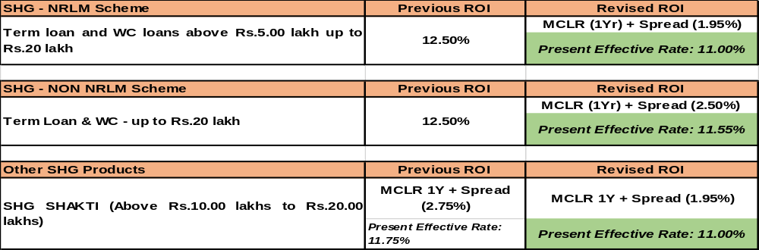
Highlights of Revision in ROI for SHG AGRI Loans
The above revision is applicable for SHG accounts under Agriculture Sector only.
Take advantage of the significant reduction in ROI to garner quality additional business under SHG agriculture, which in turn will improve Bank’s lending to Agriculture.

Slide 37

Assessment
Scheme
Eligibility
Based on the Scale of finance for the crop x Extent of area cultivated + 10% of limit towards post-harvest / household / consumption requirements + 20% of limit towards repairs and maintenance expenses of farm assets
Extended to Farmers for Crop cultivation & Allied activities
All Farmers, Tenant Farmers, Oral lessees, SHG/JLG
KCC SCHEME GUIDELINES
Collateral Security
IRAC Norms
Interest Subvention
Validity
Crop Season based IRAC norms
Short duration : T+2 Crop Seasons
Long Duration : T+1 Crop Season
KCC Allied : 90 days delinquency norms
1.5% ISS and 3% PRI is available for KCC Crop - limit upto 3.00 lakh & KCC Allied - limit upto 2.00 lakh
For loans up to
Rs 2.00 lacs: NIL
For loans above
Rs 2.00 lacs: 100% collateral security
Valid for a period of 5 years subject to annual review

Slide 38
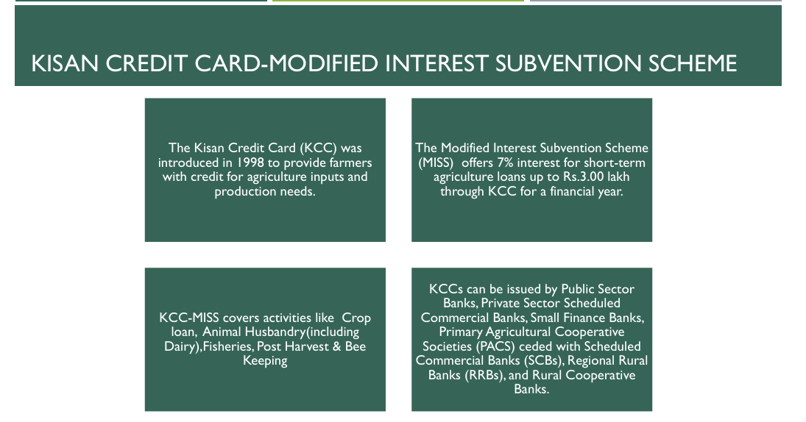

Slide 39
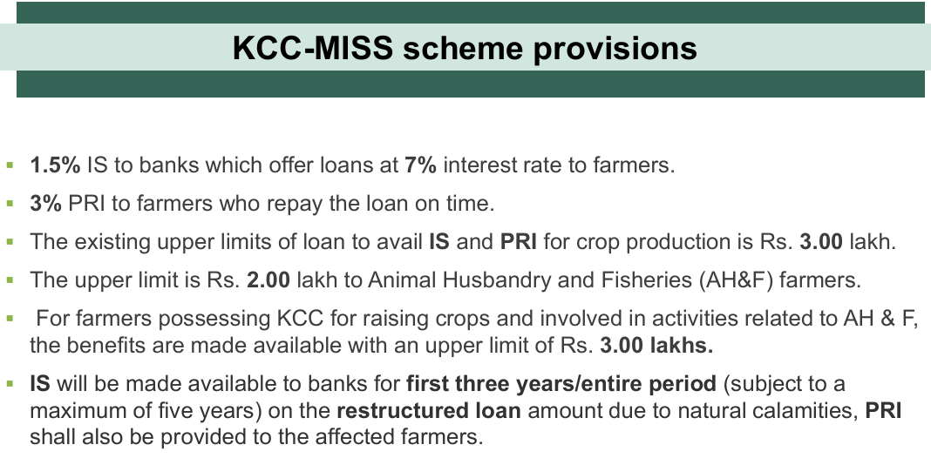

Slide 40
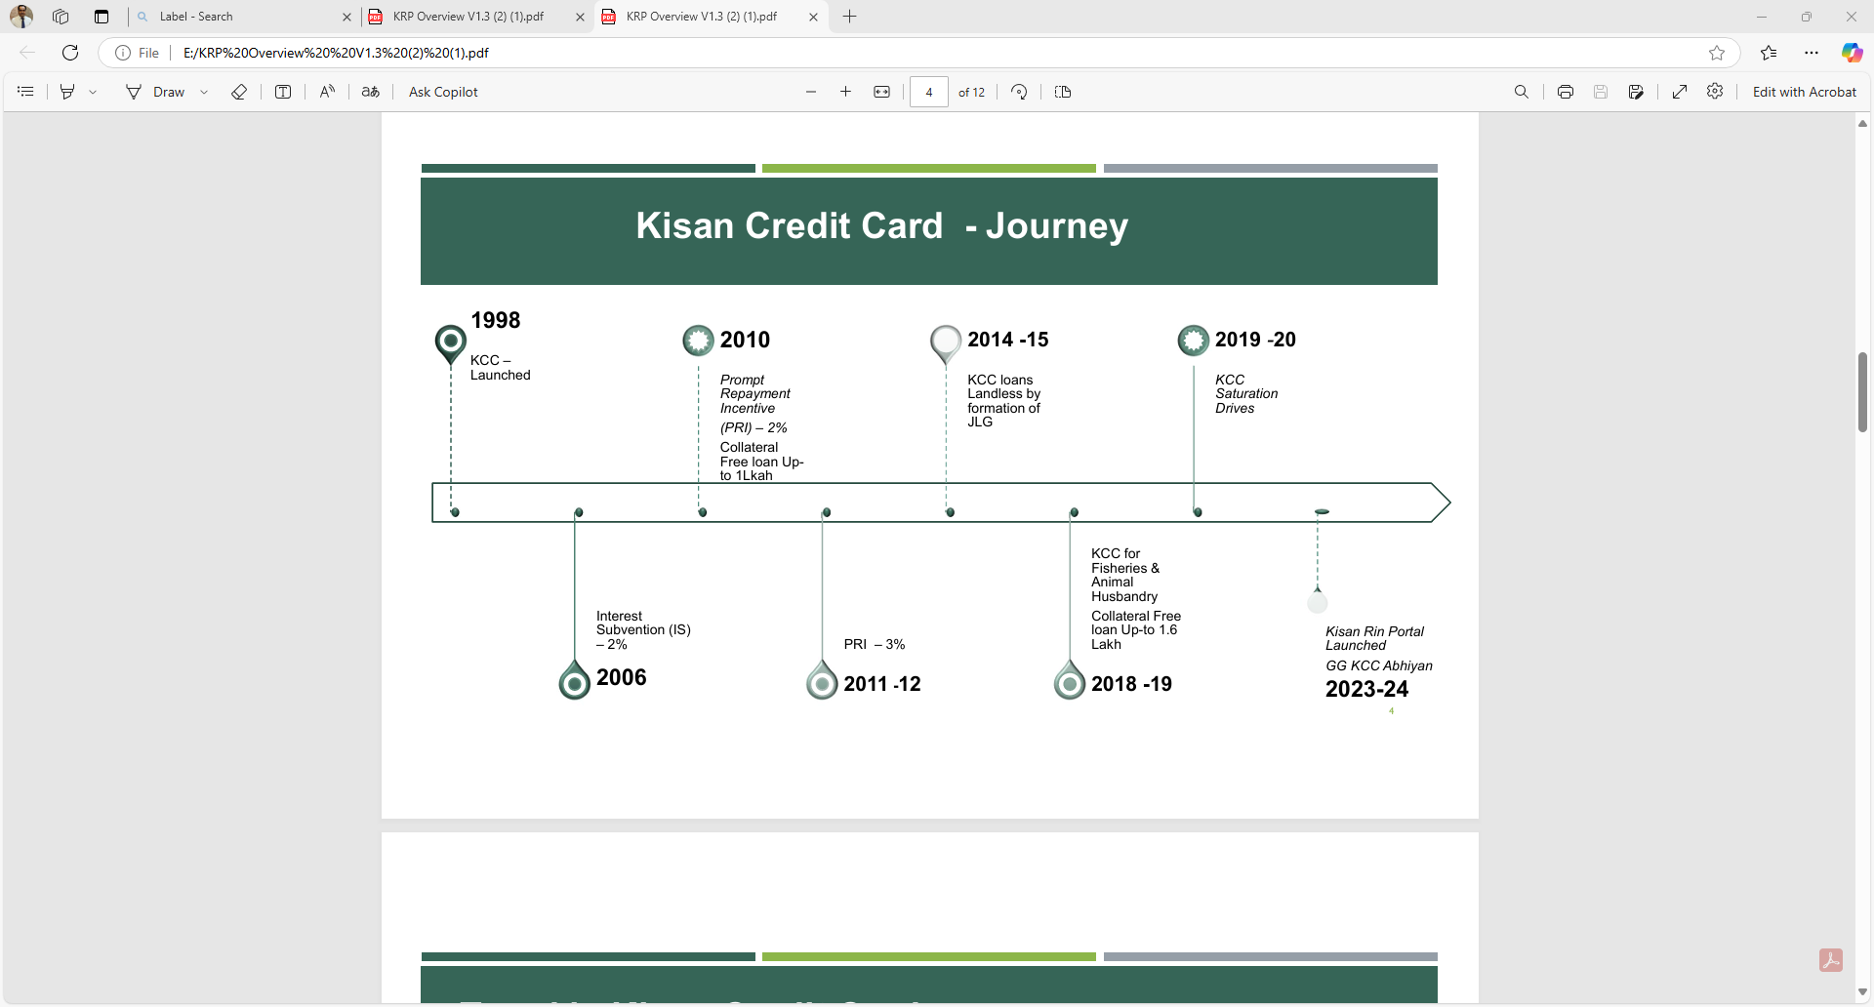

Slide 41
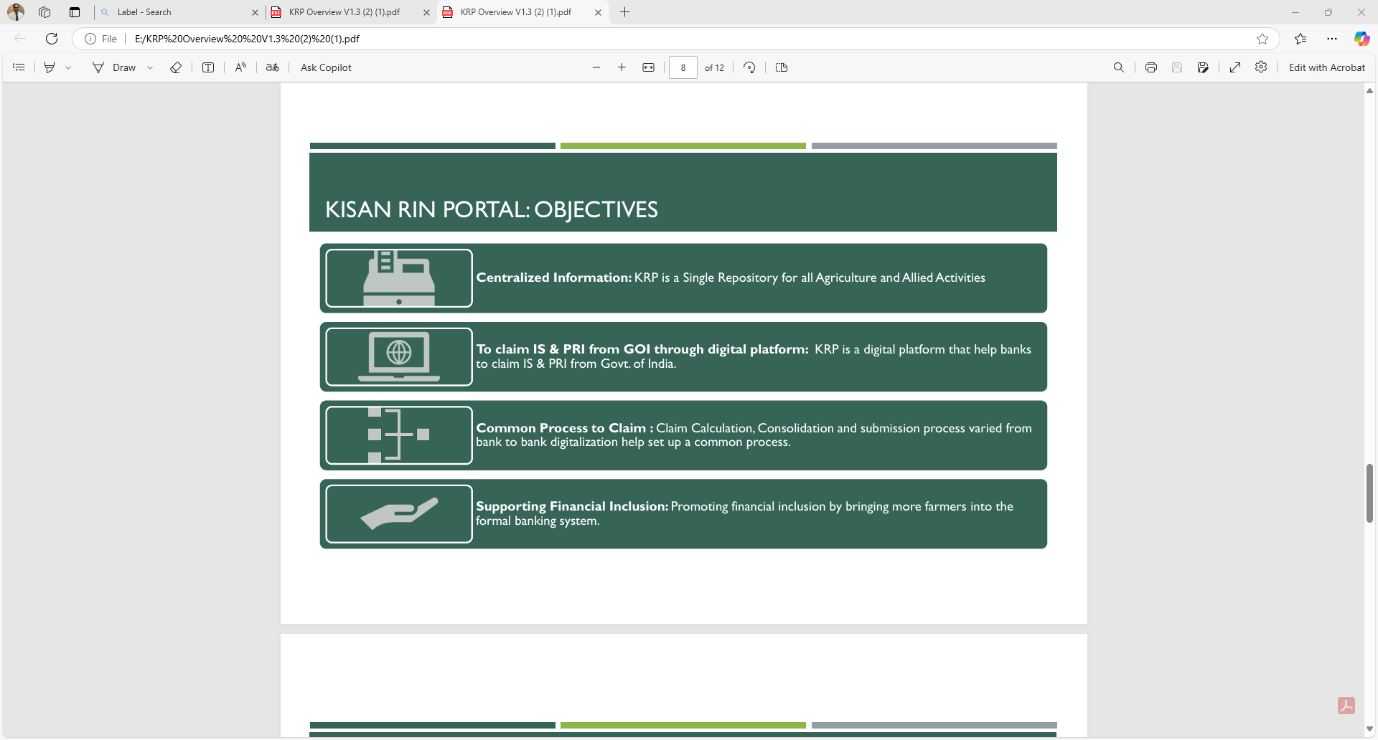

Slide 42
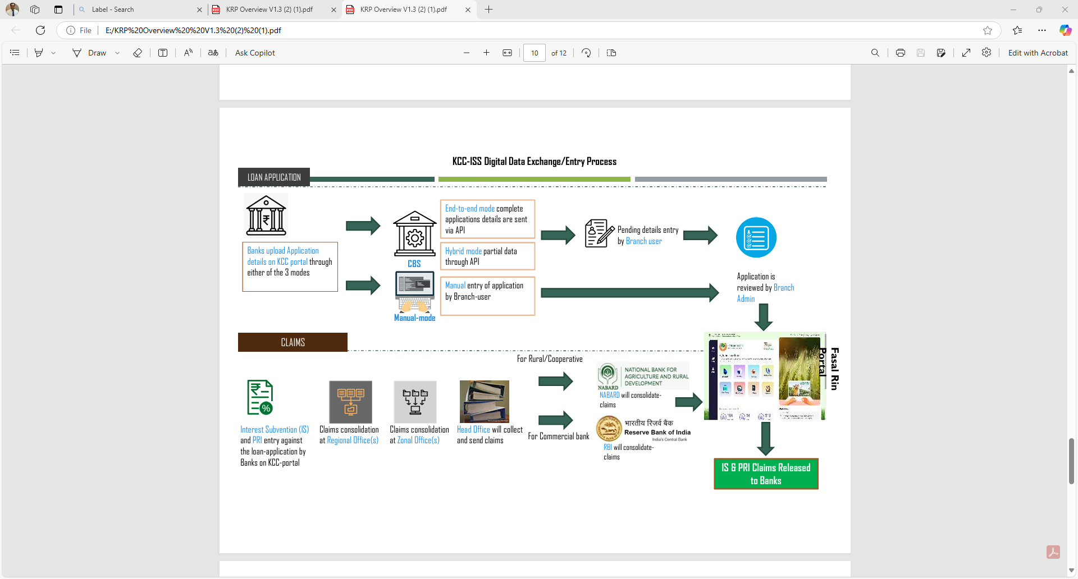

Slide 43
Vanchit Ikai Samooh aur Vargon ki Aarthik Sahayata Yojana VISVAS
provide direct benefit of lower rate of interest to the eligible Self-Help Groups (SHGs) and Individual beneficiaries
SHGs with atleast 70% members belonging to SC, OBC or Safai Karamcharis (including identified Manual Scavengers, Waste pickers, and their dependents)
SHG eligible for interest subvention upto 5% p.a. for loans/cash credit limits up to Rs 10.00 lakh.
Similarly, individuals belonging to SC, OBC and Safai Karamcharis (including identified Manual Scavengers, Waste pickers, and their dependents) will be eligible for interest subvention upto 5% p.a. for loans up to Rs 5.00 lakh.
SC and OBC individuals with annual family income upto Rs 3.00 lakh and no income criteria will be applicable in case of Safai Karamcharis.

Slide 44
New Agri Jewel Loan Product to SHG Member
All individual active women SHG members, who are maintaining SB account with us.
Medium Term Loan ,with repayment up to 60 months depending activity
To meet their medium term credit requirements for agri allied activities
From Rs.26000/- to Rs.2,00,000/-
Loan amount to be arrived based on unit cost fixed by NABARD
Eligible Loan amount will be the lowest of Maximum Permissible Loan amount arrived as per NABARD’s unit cost or 85 % of market value of Gold Ornaments or Loan applied by the applicant
Rate of interest -1 YR MCLR

Slide 45
Tarun Plus (Allied activities)
Target Group | The Existing units/ projects who have availed and successfully repaid previous loans under Tarun Category (Mudra loans above Rs 5 lakhs to Rs 10 lakhs) from time to time to be complied
Purpose | All allied activitiesg. Pisciculture, Bee keeping, Poultry, Livestock rearing, grading, sorting, aggregation, Agro industries, Dairy, Fishery, Agri Clinic and Agribusiness centers, Food and Agro processing e
Loan Amount | Minimum: above Rs 10.00 Lakhs Maximum: Rs 20.00 Lakhs
Margin/ROI/Tenure | 20%, 1YR MCLR+ Spread(3) Maximum Repayment : Upto 84 Months for Term Loans

Slide 46
ELIGIBLE CATEGORIES UNDER PRIORITY SECTOR
Loans against pledge/hypothecation of agricultural produce (including warehouse receipts) for a period not exceeding 12 months subject to a limit up to ₹75 lakh against NWRs/eNWRs and up to ₹50 lakh against warehouse receipts other than NWRs/eNWRs
Loans will be subject to an aggregate limit of ₹2 crore per borrowing entityCorporate farmers, Farmer Producer Organisations (FPOs)/(FPC) Companies of Individual Farmers, Partnership firms and Co-operatives of farmers engaged in Agriculture and Allied Activities
Loans for agriculture infrastructure will be subject to an aggregate sanctioned limit of ₹100 crore per borrower from the banking system
Loans up to ₹5 crore to co-operative societies of farmers for purchase of the produce of members (Not applicable to UCBs)
Loans up to ₹50 crore to Start-ups, as per definition of Ministry of Commerce and Industry, Govt. of India that are engaged in agriculture and allied services.
Loans for Food and Agro-processing up to an aggregate sanctioned limit of ₹100 crore per borrower from the banking system
Bank credit to registered NBFCs (other than MFIs) towards on-lending for ‘Term lending’ component under agriculture will be allowed up to ₹ 10 lakh per borrower

Slide 47
Agri Infra Fund (AIF)
Announced in May 2020 by the Central Govt.
Financing facility of Rs 1 lakh crore will be provided for funding Agriculture Infrastructure Projects at farm-gate & aggregation points.
Bank has launched “Ind Krishi Infra Fund” (Ref ADV-101 dt 14.08.20 & ADV-137 dt 29.09.20)
Target Group – PACS, FPO, SHG, Farmer, JLG, Marketing Cooperative Societies, Agri entrepreneurs, Startups, Central/ State Agency or Local Body sponsored PPP Projects
Purpose –
    Post Harvest Management Projects
    Viable Projects for building community farming assets
Type of Facility- Term loan
Loan Amount – As per Project Cost
Margin – Minimum 25%

Slide 48
AGRI INFRA FUND
Loan Tenor – Maximum 7 years including 6 to 24 months of moratorium
Interest Subvention - @ 3% p.a. up to a limit of Rs 2 Crore for a maximum period of 7 years.
Credit Guarantee – CGTMSE up to Rs 2 Crore.
The fee for this coverage will be paid by the Government.
In case of FPOs, guarantee to be availed from the facility created under FPO promotion scheme of DACFW.
Other Conditions –
Any grant or subsidy available under any other present/ future schemes may also be availed by the concerned beneficiaries.
Interest Subvention & Credit Guarantee support will be released to banks through PFMS

Slide 49

Animal Husbandry Infrastructure Development Fund (AHIDF)
Announced under Aatmanirbhar Bharat package by the Central Govt.
Fund size of Rs 15000 Crore has been formed for incentivizing investments for establishment of
  Dairy/ Meat Processing & value addition infrastructure
  Animal Feed Plant
Bank has launched “Ind Pashudhan Mitra” (Ref ADV-144 dt 01.10.20)
Target Group – Individual entrepreneurs, Pvt Cos, MSME units, FPOs & Section 8 Cos (Non-profit entities)
Purpose –
    Dairy Processing & value addition infrastructure
    Meat Processing & value addition infrastructure
    Animal Feed Plant
Loan Amount – As per Project Cost

Slide 50
Animal Husbandry Infrastructure Development Fund (AHIDF)
Margin –
  Micro & Small Enterprises – Min 10%
  Medium Enterprises – Min 15%
  Other Categories – Min 25%
Loan Tenor – Maximum 10 years including maximum moratorium of 24 months
  Interest Subvention - @ 3% p.a. for Plant and Machinery component.
  Credit Guarantee up to 25% by NABARD up to MSME defined ceilings.
URL to access the portal : https://udyamimitra.in/
User ID : IFSC code in Small for Branches.
Password : Can be reset by Zonal Office .
Zonal offices/ Branches can access the applications by the user credentials of PM-SVANIDHI scheme.
Maximum TAT is 30 Days for disposal of application from portal

Slide 51
PMFME
PM- Formalization of Micro Food Processing Enterprises (PM-FME)
Increased access to credit by existing micro food processing entrepreneurs, FPOs, Self Help Groups and Co-operatives;
Integration with organized supply chain by strengthening branding & marketing;
Increased access to common services like common processing facility, laboratories, storage, packaging, marketing and incubation services;
Strengthening of institutions, research and training in the food processing sector; and increased access for the enterprises, to professional and technical support.

Slide 52
Target Group/Subsidy Grant
Target Group:
The existing individual Micro Food Processing Enterprises, as well as groups such as SHGs/ FPOs/ Cooperatives for up-gradation of their food processing activities.
New units would be supported for ODOP products.
Subsidy Grant:
Credit linked subsidy @ 35%, with maximum subsidy of Rs. 10.00 Lakhs.
Credit linked capital investment Grant @ 35 % to FPOs/ SHGs/ Cooperatives.
Grant @ 35% for common infrastructure development by groups, government agencies or private entities.
Credit Guarantee Fund Trust for Micro & Small Enterprises (CGTMSE) for collateral free loan up to Rs 2 crore & PM MUDRA Yojana for loan up to Rs.10 lakh to be covered as per the eligibility norms.

Slide 53
Other info:
Ministry of Food Processing Industries (MoFPI) has formulated the Scheme to address the challenges faced by the MICRO Enterprises & to tap the potential of groups & cooperatives in supporting the upgradation & formalization of such enterprises.
Bank has launched the following products (Ref ADV-148 dt 05.10.20)
  IND MICRO Food Processing Enterprises (PMFME) – Individual
  IND MICRO Food Processing Enterprises (PMFME) - Group
Loan Amount – As per Project Cost
Margin – Minimum 10%
Loan Tenor – Maximum 15 years including maximum moratorium of 12 months
Credit Guarantee –
  Up to Rs 2 Crore from CGTMSE.
  For loans up to Rs 10 lakhs to MICRO units MUDRA guarantee from CGFMU
  Loans to SHGs above Rs 10.00 lakhs & up to Rs 20.00 lakhs to be covered under CGFMU

Slide 54
PM- Kisan Urja Suraksha evam Utthaan Mahabhiyan Yojana (PM-KUSUM)
Announced under Aatmanirbhar Bharat package by the Central Govt
Bank has launched “IND KISAN SAUR SHAKTHI” (Ref ADV-258 dt 06.03.21)
Target Group – Individual/ group of farmers, cooperatives, panchayats, FPO, Water User Associations, Proprietorship/ Partnership firms, etc.
Purpose – For installation of solar pumps.
Scheme Components –
  For setting up of 10,000 MW of Decentralized Grid Connected Renewable Energy Power Plants on barren land
  Installation of stand alone solar pumps of capacity up to 7.5 HP
  Solarization of 10 lakh Grid connected agriculture pumps
Loan Amount – As per Project Costs approved by the Competent Authority (MNRE/ State Govts)
Margin – Minimum 10%
Loan Tenor – Maximum 5 years including maximum moratorium of 6 months
Subsidy/ Grant – CFA @ 30% (50% for NE, Sikkim, J&K, HP, Uttarakhand, Lakshadweep and A&N Islands) of the Benchmark Cost or the Tender Cost (whichever is lower) of the stand alone agri solar pump shall be provided. Subsidy @ 30% is also available from the State Govts.
Other Conditions–
  The borrower may purchase solar pump of higher capacity, but financial assistance shall be available for corresponding pump capacity up to 7.5 HP.
  Only MNRE empanelled vendors of solar pump models are eligible for purchase under the scheme.

Slide 55
Sustainable Alternatives Towards Affordable Transportation (SATAT)
The SATAT Scheme on CBG (Compressed Bio Gas) was launched by MoPNG, GoI on 01.10.2018.
Bank has launched “Scheme for Financing Compressed Bio Gas Plants under SATAT”
(Ref ADV-145 [Sr No -20432] dt 07.10.21)
Target Group –Entities permitted by MoPNG who have been awarded Letters of Intent (LOI) by OMCs for production & supply of CBG.
Purpose – Setting up of Compressed Bio Gas plant with minimum production capacity of 2 Tons per day.
Loan Amount – As per Project Cost
Margin –
  Term Loan - Minimum 25%
  Working Capital – Minimum 30%
  LC – 10%
  BG (Performance) – 10-25%
Loan Tenor – Maximum 15 years including moratorium of 6 to 24 months
Subsidy – CFA of Rs 4.00 Cr per 4800 kg of CBG production per day generated from 12000 cubic meters of Bio gas subject to a Max CFA of Rs 10 Crore
Other Conditions - Execution of agreement between CBG Plant Owner and Oil Marketing Companies (OMC) with important clauses; Project land will NOT be considered as part of Project Cost.

Slide 56
PMEGP Guidelines
Generate employment opportunities in rural as well as urban areas of the country through setting up of new self-employment ventures/projects/micro enterprises.
To bring together widely dispersed traditional artisans/ rural and urban unemployed youth and give them self-employment opportunities to the extent possible, at their place.
To provide continuous and sustainable employment to a large segment of traditional and prospective artisans and rural and urban unemployed youth in the country, so as to help arrest migration of rural youth to urban areas.
To increase the wage earning capacity of Workers and artisans and contribute to increase in the growth rate of rural and urban employment

Slide 57
Level of Support under PMEGP
Categories of Beneficiary under PMEGP | Beneficiary Contribution | Rate of subsidy
Area (location of project/unit) |  | Urban | Rural
General Category | 10 | 15 | 25
Special (including SC / ST / OBC /Minorities/Women, Ex-servicemen, Physically handicapped, NER, Hill and Border areas etc. | 5 | 25 | 35

Slide 58
Maximum Project cost
(New)
The maximum cost of the project/unit admissible for Margin Money subsidy under Manufacturing sector is Rs. 50 lakhs.
The maximum cost of the project/unit admissible for Margin Money subsidy under Business/Service sector is Rs. 20 lakhs.
The balance amount (excluding the own contribution)of the total project cost will be provided by Banks.
If the total project cost exceeds Rs. 50 lakhs or Rs. 20 Iakhs for Manufacturing and Service/Business sector respectively, the balance amount may be provided by Banks without any Government subsidy.

Slide 59
2td Loan for upgradation of existing PMEGP
Categories of beneficiaries under PMEGP (for upgradation of existing units) | Beneficiary's contribution (of project cost) | Rate of Subsidy (of project cost)
All Categories | 10% | 15% (20% in NER and Hill States)

Slide 60
For 2nd dose (PMEGP)
The maximum cost of the project/unit admissible for Margin Money subsidy under Manufacturing sector for upgradation is Rs. 1.00 crore. Maximum subsidy would be Rs.15 lakh (Rs.20 lakh for NER and Hill States).
The maximum cost of the project/unit admissible for Margin Money subsidy under Business/Service sector for upgradation is Rs. 25 Iakh. Maximum subsidy would be Rs.3.75 lakh (Rs.5 lakh for NER and Hill States).
The balance amount (excluding the own contribution)of the total project cost will be provided by Banks.
If the total project cost exceeds Rs. 1.00 Crore or Rs. 25.00 Iakhs for Manufacturing and Service/Business sector respectively, the balance amount maybe provided by banks without any Government subsidy.

Slide 61
POLICY ON FI & BC MANAGEMENT
IB SAATHI – Sustainable Access and Aligning Technology for Holistic Inclusion(IB SAATHI)
The new model is a hybrid model.
BCs in this model shall offer banking services at the allotted locations for a minimum of 4 hours in their fixed setup.
Thereafter, BC agents will be mobile i.e., move to any other uncovered area within their Service Area and offer doorstep services.
The timings shall be decided by ZM.

Slide 62
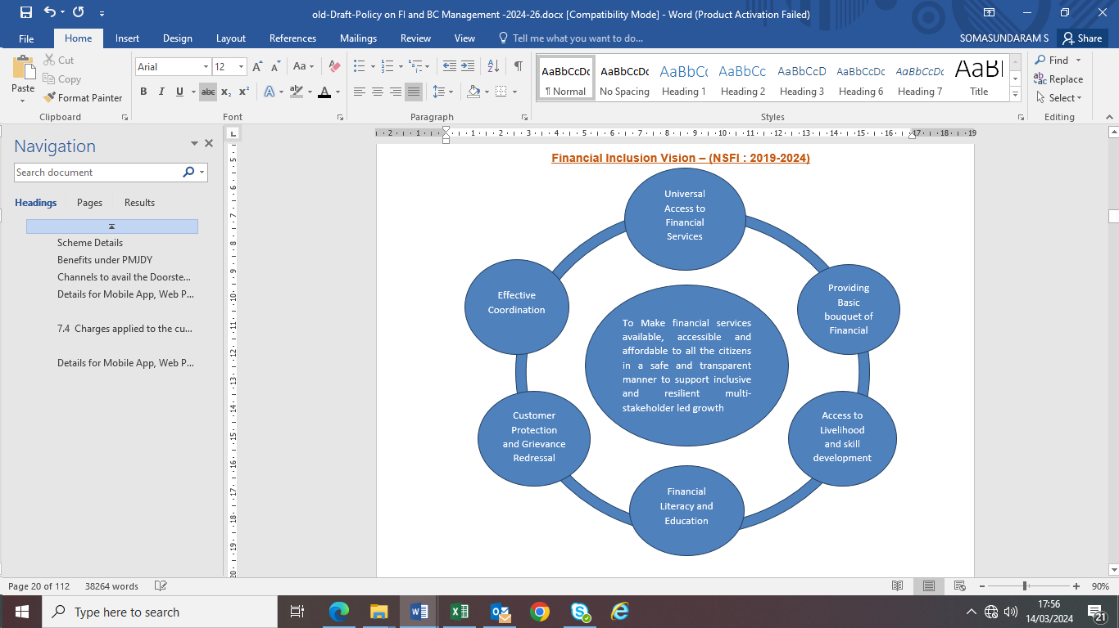
Financial Inclusion - NSFI
Financial Inclusion is “the process of ensuring access to financial services and timely & adequate credit where needed by vulnerable groups such as weaker sections and low income groups at an affordable cost.”

Slide 63
Minimum AND Maximum Distance
There is no minimum distance criteria from the Base Branch to the BC location, with a covenant that no BC shall operate inside / near to the Branch Premises (i.e., not placing a BC within 500 metres radius from Branch), subject to compliance of NRLM guidelines.
With regard to maximum distance criteria, the distance between the place of business of a BC (BC Location / BC Point) and the base branch should ordinarily not exceed 10 KMs in rural, semi-urban (non SSA) and urban areas and 5 KMs in metropolitan centres. However, Zonal Managers/ Zonal Heads may permit / decide upon the maximum distance criteria, on a case to case basis.
While recommending such applications, beyond the specified distance criteria, BCAC must comment upon the parameters specified

Slide 64
Approval of New BC Location / Engagement / Replacement of BC
BCAC Committee –
Constitution
(1) Zonal Manager – Chairman & Member
(2) Deputy Zonal Manager/ Second-inCommand - Member
(3) CMs / SMs in Zonal Office - Two Members
(4) FI Nodal Officer in charge of FI activities at ZO as Convener.

Slide 65
Monitoring of Bcs
An officer from ZO - Quarterly, atleast 25% of the BC locations in the Zone should be visited. i.e, every year atleast once, all the BC locations in the Zone are to be visited by any officer from ZO.
Branch Manager / Officer of the BC’s Base Branch should make surprise visit once in a month to the BC locations to check the working of the Field BCs and Cash held by them

Slide 66
Payment of Commission and Renumeration
Bank at its discretion may declare incentives / awards / performance recognition systems for FBCs directly without 20% share of the CBCs.
The Executive Director in-charge of FI Department is the Competent Authority for any amendments to the remuneration structure for the CBC / BC

Slide 67
Inactive BC
Bc /Bank Mitra Shall be treated as inactive, If he/she has not done any (Financial/Non Financial) transaction /log in in the last 3 months( 90 days)
Review of BC inactivity to be carried out periodically at least quarterly basis.

Slide 68
MCQs on FI AND AGRI

Slide 69
What is the maximum tenure for repayment of Retail Jewel Loans in EMI mode? a) 12 months b) 24 months c) 35 months d) 48 months
  Answer: c) 35 months

Slide 70
What is the maximum number of jewel loans a customer can avail at any point of time, including Agri, Retail, and MSME? a) 3 b) 4 c) 5 d) 6
  Answer: c) 5

Slide 71
Who should be the sanctioning authority if the existing and proposed Jewel Loan amount exceeds Rs.10.00 lakh per borrower? a) Branch Manager b) Zonal Manager c) Assistant Branch Manager d) Jewel Appraiser
  Answer: a) Branch Manager

Slide 72
What is the maximum amount of gold coins that can be accepted as security per customer? a) 10 grams b) 25 grams c) 50 grams d) 100 grams
  Answer: c) 50 grams

Slide 73
What is the compensation value for stones/gems pledged by the customer? a) 5% of value or Rs.5,000/-, whichever is lower b) 10% of value or Rs.10,000/-, whichever is lower c) 15% of value or Rs.15,000/-, whichever is lower d) 20% of value or Rs.20,000/-, whichever is lower
  Answer: b) 10% of value or Rs.10,000/-, whichever is lower

Slide 74
Within how many months should the auction be conducted from the date of overdue? a) 3 months b) 6 months c) 9 months d) 12 months
  Answer: b) 6 months

Slide 75
What is the trigger Loan-To-Value (LTV) percentage for Agri Jewel loans? a) 70% b) 75% c) 85% d) 90%
  Answer: d) 90%

Slide 76
What is the maximum number of decimals allowed for the weight of gold entered in CBS? a) 1 decimal b) 2 decimals c) 3 decimals d) 4 decimals
  Answer: c) 3 decimals

Slide 77
What is the minimum carat fineness for jewels to be accepted as security for a loan? a) 18 carats b) 20 carats c) 22 carats d) 24 carats
  Answer: a) 18 carats

Slide 78
Which feature is NOT included in the Mobile App for Panel Jewel Appraisers? a) Capturing images of pledged jewels b) Digital valuation certificate c) Online loan disbursement d) Unique ID generation
  Answer: c) Online loan disbursement

Slide 79
What is the maximum fee structure for jewel appraisal in metro cities? a) Rs.300/- per loan b) Rs.400/- per loan c) Rs.500/- per loan d) Rs.600/- per loan
  Answer: c) Rs.500/- per loan

Slide 80
How often should the quality of jewel appraisal be reviewed by branches? a) Monthly b) Quarterly c) Annually d) Bi-annually
  Answer: b) Quarterly

Slide 81
What is the maximum distance between base branch and BC Point in Rural, Semi urban and Urban areas?
5 km
10 km
15 km
25 km
Ans: b) 10 km

Slide 82
How many CBCs are at present in our Bank?
10
20
15
25
Ans: b) 20

Slide 83
What is the lien period (insurance cover shall not be available for death (other than due to accident) ) for PMJJBY?
First 30 days from the date of enrolment into the scheme
First 45 days from the date of enrolment into the scheme
First 60 days from the date of enrolment into the scheme
First 90 days from the date of enrolment into the scheme
Ans: a) First 30 days from the date of enrolment into the scheme

Slide 84
How many INDSETIs are there in Indian Bank?
35
37
39
36
Ans: b) 37

Slide 85
Who is the Grievance Redressal Officer (GRO) at ZO level to address the deficiencies in services if any, rendered by Business Correspondents?
Zonal Manager
Deputy Zonal Manager
CM- FI Nodal Officer
CM - HR
Ans: a) Zonal Manager

Slide 86
What is the age limit to avail OD facility under PMJDY?
18-60 years
18-50 years
18-65 years
18-55 years
Ans: c) 18-65 years

Slide 87
Which model is followed by the Bank for Technical Service Provider?
a) CAPEX
b) OPEX
c) Both A & B
d) None of the above
Ans: CAPEX

Slide 88
What is IB SAATHI?
IB Specific Access and Assisting Technology for Holistic Inclusion
IB Sustainable Access and AI Technology for Holistic Inclusion
IB Sustainable Access and Aligning Technology for Holistic Inclusion
None of the above
Ans: c) IB Sustainable Access and Aligning Technology for Holistic Inclusion

Slide 89
Who is the competent authority for any amendments to the remuneration structure for the CBC / BC?
COLCC (GM)
COLCC (ED)
Executive Director in-charge of FI Dept.
GM (Financial Inclusion Dept.)
Ans: c) Executive Director in-charge of FI Dept.

Slide 90
What is the frequency of surprise visit by Branch Manager / Officer of the BC’s Base Branch to monitor field BCs?
Once in a week
Once in a Fortnight
Once in a month
Once in a quarter
Ans: c) Once in a month

Slide 91
Who will give due approval for CBC - Selection Criteria, Terms & Conditions, Security Deposit specified in the respective RFP as per the requirements of Bank and at the time of floating RFP?
COLCC (GM)
COLCC (ED)
ED in-charge of FID
GM (FID)
Ans: c) ED in-charge of FID

