Slide 1


Retail Loan Scheme
Mithu Kumar jha
Cm & faculty

Slide 2
Home loan Residents
Eligibility :
Salaried Class / Businessman / P&SE:
1-Resident individuals having steady source of income- - Salaried Class, Businessmen, Professional and Self-employed
2- Regular employees* of Central Government / State Government / Public Sector Undertakings / Government or Government aided Educational Institutions with salary statement from the existing employer for at least previous 3 months.
3- Regular employees* of MNCs/Reputed Companies (Externally rated as BBB or above) with salary statement from the existing employer for at least previous 3-months ( experience of minimum 2 years)
Regular employees will not include Adhoc / Contract/ Casual Employee
4-Home loan to HUF should not be considered

Slide 3

Age of the applicants
Minimum entry age is 18 years and Maximum exit age is 70 years
50% of the balance outstanding in the home loan account at the time of retirement’ is to be paid out of the terminal benefits (in case of retirement)
RAPCLCC & above can consider exit age up to 75 years for applicants whose income is taken for eligibility
RAPCLCC & above can also permit relaxation in exit age beyond 75 years for applicants whose income is not reckoned for eligibility / recovery where-
• The names are included for family / sentimental / legal / other reasons and
• Other applicants’ income alone is reckoned for eligibility and repaying capacity

Slide 4
Co borrower
Their income is regular & backed by income proof
Number of such Co-applicants should be generally restricted to three (i.e. one Applicant + three Co-applicants) (More than this ZLCC Power)
In case of income of parents taken for eligibility calculations, NOC from all the Legal heirs to be obtained for considering income of the parents
Who are not close relatives, but they are crowners and co-borrowers in the proposal up to RAPC level, can be considered subject to administrative approval of ZLCC

Slide 5
Income Criteria (Business Class)
In case of Professional & Self-employed / business category – based on average of latest two years’ subject to the applicants have minimum 3 years’ experience in the business.
RAPCLCC/ZLCC may consider the higher of the following
a) Income as per latest IT Return + Depreciation claimed
b)5% of annual sales revenue as per latest audited balance sheet

Slide 6
Quantum of Loan /Eligibility
Loan will be considered based on monthly NTHP criteria (as applicable) only.
If Gross Annual Income of the Applicants (Individually or Jointly) is up to Rs.15.00 lakhs, take home income should not be less than 40% of the Gross Annual Income.
If Gross Annual Income of the Applicant (Individually or Jointly) is above Rs.15.00 lakhs, NTHP should be minimum Rs.50000 per month.
60% of future rental income from the property to be purchased / constructed /owned by the applicant can also be include

Slide 7

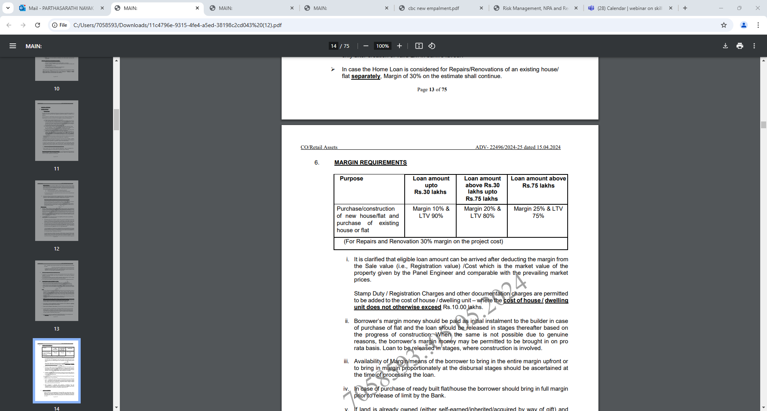



Margin Requirement

Slide 8
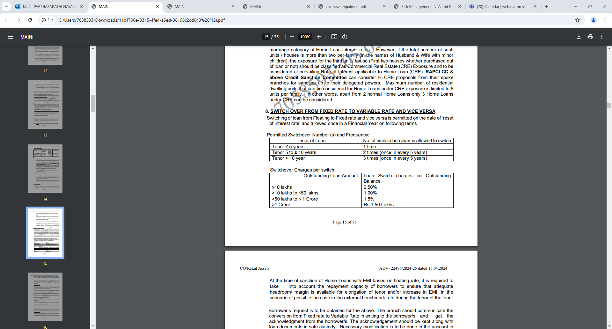
Swicthover of interest rate

Slide 9
Period of Loan
The maximum repayment period is restricted to 30 years for Home Loan accounts (inclusive of holiday period) (or) Up to the age of 70 years whichever is earlier.
For take over accounts, the repayment period can be extended beyond the period sanctioned by the original lender subject to a maximum of 30 years (or) Up to the age of 70 years (the age by which the loan should be fully repaid).
Maximum repayment period for Home Loan for Repairs and Renovation is 10 years.
Commercial Real Estate (CRE) for borrowers (Other than Salaried Class), maximum loan tenor will be 25 years.

Slide 10
Moratorium
Details of underlying transaction | Holiday period | Sanctioning Authority
Outright purchase of house/flat | Nil. However, on case to case basis, maximum 6 months can be permitted | Respective Sanctioning Authority
For construction of house on the plot already owned by the applicant | Maximum 18 months | Respective Sanctioning Authority
Purchase of Plot and construction of house thereof / flat under construction by promoters / developers | Maximum 24 months | Respective Sanctioning Authority
Flat under construction - in case of bigger projects | maximum 36 months | RAPCLCC and above
 | Above 36 months | ZLCC and above

Slide 11
Lease Hold Property
Owned by Central Government/ State Government/Other Government bodies, subject to satisfactory legal opinion on the original lease deed which conveys the leasehold rights
NOC / Mortgage permission from these authorities is to be obtained
Lease is on perpetual basis
The residual lease period is at least three years or more than the loan repayment period
No disputes relating to the lease or its extension / Lease amount etc.
NOC is required both from the Assignor as well as the Original Lessor, at the time of creation of mortgage and effecting sale.
The loan beyond the residual period of lease in case of perpetual lease, may be permitted by FGMCAC on case to case basis.

Slide 12
Group Mortgage Redemption Assurance Scheme (GMRA)
Premium paid under the Policy is eligible for tax benefit under Sec.80C of Income Tax Act
one-time Premium payment can be either financed by bank as a separate clean loan or paid by the borrower himself
GMRA Scheme ‘IB HOME SURAKSHA’ - by arrangement with M/s Kotak Mahindra & Aditya Birla Sun life Insurance Company Ltd.
Maximum 60 months – Repayable in 60 EMIs (maximum) commencing from the next month of disbursement of loan (No Holiday period permitted)

Slide 13
IB HOME LOAN TO ( NON RESIDENT INDIANS)
Eligibility:NRIs gainfully employed abroad (who have put in a minimum period of confirmed service / experience of 2 years - including previous employment / experience and confirmed in the present employment)
With a residual contract period of service for at least three more years to run NRI professionals with a regular monthly income are also eligible

Slide 14
Age of Applicant:
Entry Level: Between 21 and 50 years
Exit Level: Maximum 60 years
ZLCC may permit the following on selective basis
a) Relaxation upto 60 years at entry level and upto 70 years at exit level.
b) Waiver of minimum period of residual service wherever renewal of employment contract / alternate employment is assured

Slide 15

Repayment Period
Maximum 20 years, including holiday period

Slide 16
Moratorium
Details of underlying transaction | Holiday period | Sanctioning Authority
Outright purchase of house/flat | Nil. However, on case to case basis, maximum 6 months can be permitted | Respective Sanctioning Authority
For construction of house on the plot already owned by the applicant | Maximum 18 months | Respective Sanctioning Authority
Purchase of Plot and construction of house thereof / flat under construction by promoters / developers | Maximum 24 months | Respective Sanctioning Authority
Flat under construction - in case of bigger projects | maximum 36 months | RAPCLCC and above
 | Above 36 months | ZLCC and above

Slide 17
LOAN FOR PURCHASE OF HOUSE SITE / PLOT BY RESIDENTS / NRIs
Eligible Borrower | As applicable to Home loan to Residents / NRIs
Purpose of Loan | Purchase of house site on ownership basis (not on lease basis) layout of which is duly approved by competent authority

Slide 18
Quantum of loan(Plot)
Permitted up to 36 times of the Gross Monthly Income (as per latest salary slip – for salaried class)
3 times of Annual Net Income (In case of Professional & Self-employed / business class)
Rural area -100 lacs, Semi urban-200 lacs ,Urban-600 lacs, Metro-1200 lacs

Slide 19
Margin/ ROI
MARGIN | Minimum 25% for residents and NRIs on the Cost of the Plot.
Rate of Interest | Plot loan carry additional interest of 1% over and above the applicable interest rate for Home loan

Slide 20
Repayment Period
Maximum 180 EMIs.
No holiday period to be allowed

Slide 21
IB IMPROVE
ELGIBILILTY | Existing Home Loan borrowers (both residents & non-residents) including our staff members. Prospective home loan borrowers who are salaried class customers / professionals / business people. Our staff members who had availed SHL are also eligible to avail against extension of EM of SHL property.
Purpose | Purchase of household furniture, interior decorations, Air-Conditioners, Kitchen chimney, modern gadgets for kitchen/modular kitchen & piped gas supply/cost of digging bore well, with suitable water lifting devices like jet pump set, compressor, solar system and immersible pump set. Branches can include the cost of Rooftop Solar PV Home Lighting System as an eligible item for providing loans to all eligible applicants (as part of the total project cost) under Home Loan / Home Improve Schemes

Slide 22
Quantum of Loan
Based on the monthly NTHP maximum of Rs.300 lakhs.
Income of Spouse / Other Co-applicants whose income was reckoned for calculation of Home Loan eligibility / recovery can be included for availing this facility also.
Income of spouse / adult children can be included even if not originally reckoned for Home Loan.
However, income of other relatives cannot be added afresh for availing this facility.

Slide 23
MARGIN/TAKE HOME/REPAYMENT
MARIN | 15% of cost of the articles to be purchased under the loan.
TAKE HOME | For Gross Annual Income of the Applicants (Individually of jointly) is up to Rs.15.00 lakhs, take home income should not be less than 40 % of the Gross Annual Income Gross Annual Income of the Applicants (Individually of jointly) is more than Rs.15.00 lakhs, NTHP should not be less than Rs.50000 per month
REPAYMENT | Maximum 120 months

Slide 24

Home Loan Enrich

Slide 25
Home Loan Enrich
Target Group:
Resident individuals & NRIs having steady source of income - Salaried Class,
Businessman, Professional and Self employed people,
Pensioners - Who have put in a minimum period of confirmed service / experience of 3 years (including previous employment / experience and confirmed in the present employment).
Staff of our Bank as well as Spouse of the staff can also avail this Loan.
In such case the guarantee of Spouse / Staff is compulsory. In case of Staff related (other than spouse) loans, personal guarantee of staff need not be insisted.
Our Existing Home loan customers can also avail this loan

Slide 26
Age/Quantum/Margin/Repayment
Age | Min Entry Age- 18 Max Entry Age- 65 Max Exit Age-70 (ZLCC Extend 75)
Quantum of Loan | Minimum: Rs. 1 lakh Maximum loan – Rs.10.00 lakhs Maximum loan limited to 70% of the security or 70% on estimated cost of repairs and renovation, whichever is lower
Margin | 30%(ZLCC Can relax 5%)
Repayment period | 10 years subject to maximum exit age of 70

Slide 27
Security
Lien on our Bank Term Deposits (except IB TAX Saver) including interest accrued net of TDS
i) Deposits can be in the name of individual/Joint names. ii) Third party deposits can also be accepted. However, guarantee from such third party should be obtained
2) Pledge of NSCs (incl. int. acrd.), which have run for a minimum period of 3 years
3) LIC policies - Assignment of Life Insurance Policies (to the extent of surrender value of the policy) etc. LIC policies should have run for a minimum period of 3 years

Slide 28

Eligibilty
HOME LOAN TO CORPORATE ENTITY
Should be in line of business for at least 3 years
Should have earned uninterrupted Net Profit in last 3 FYs and should have positive net worth.
Existing loan accounts of the Company,( if any), should be regular and standard and also should not have been restructured during the last three years.
Respective Sanctioning authority can consider as under: External Credit Rating of BBB & above or
If External Rating is not mandatory for the Corporate, then
Internal Rating A & above
CMR Ranking: 1-4

Slide 29
Loan Quantum/Loan tenure/LTV Ratio
Quantum | For properties situated / constructed at Semi Urban / Urban areas: Minimum Rs.50 Lakhs, Maximum Rs.200 Lakhs. Metro areas: Minimum Rs.100 Lakhs, Maximum Rs.500 Lakhs. For loan amount beyond above limits, the same may be considered by FGMCAC & above up to their respective discretionary power.
Loan Tenure | 15 years Moratorium for 3 months and 36 months
LTV Ratio | 75%

Slide 30

“IB Home Loan Flexi” - Home Loan as an Overdraft

Slide 31
Category / Loan Amount
Category of Borrower | Prospective Home Loan customers under IB Home Loan Products Existing customers under IB Home Loan Products For loans under Ind Awas scheme, conversion is permitted only after receipt of entire eligible interest subsidy amount. Sanctioning of OD facility under SHL is not permitted. Average balance of Rs. 25000/- to be maintained in Savings/ Current account
Loan Amount | Minimum: Rs. 25.00 Lakhs; Maximum: No upper limit

Slide 32

Facility
Overdraft, with the following facilities:
Customers will have to pay the Equated Monthly Instalments (EMIs) as in the case of usual Home Loans
Drawing Power to be reduced on monthly basis to the extent of principal component of repayment in EMI.
Interest portion of the EMI will serve the interest obligations.
After full disbursement of Loan limit, customers will be allowed to operate the OD account..

Slide 33

Conversion of Existing Home Loan (Term Loans) to IB HOME LOAN FLEXI Account (OD)
Fully disbursed accounts with limit of Rs.25 Lakhs and above and having outstanding balance of Rs. 10 lakhs & more
The accounts should not be under moratorium and regular repayment should have started.
IRAC status of the account should be Standard and not in SMA status on the date of conversion.
Security creation/perfection should have been completed The requests from existing home loan (term loan) customer for conversion to IB HOME LOAN FLEXI account

Slide 34
Home Loan Scheme for Economically Weaker Section (EWS), Low Income Group (LIG) and Middle Income Group (MIG) individuals: Urban Areas.
Eligible Customers | Individuals with regular source of income either having minimal or no documented income or income proof but have digital footprints of banking and other economic activities. Eligible customers in metro/urban areas includes: Small traders, shopkeepers, Skilled and Semi-Skilled workers/ artisans in unorganized sector, other professional & self- employed customers. Members of SHGs, beneficiaries of PM SVANidhi, PM Vishwakarma, Mudra, Stand Up India All beneficiary groups under Pradhan Mantri Awas Yojana (PMAY) – U 2.0. Salaried customers who have put in a minimum period of confirmed service/ experience of 2 years (Including previous employment / experience and confirmed in the present employment).

Slide 35
Eligibility
Individuals/ Applicants with annual income up to ₹9 lakh having no home or one Home.
A satisfactorily maintained running Bank Account/ UPI transaction history for a minimum period of 24 months.

Slide 36
Annual income
Total annual income of applicant (s) (maximum 4) should not exceed ₹9.00 lakh. (Income of upto 4 members of the household can be combined to calculate eligibility)

Slide 37
Eligible Income for arriving at maximum loan amount
I) For Salaried Customers-
If Salaried and receiving salary through SB account, the average annual salary credit will be taken as annual income (Average for last 12 months). One off credits, which are not regular in nature, to be removed from credit summation.
The employment/work/office verification will be continued as per the existing due diligence guidelines.
Analysis of the account statement where the monthly salary is being credited will be done to ascertain the salary credit transaction, amount and its regularity / consistency.

Slide 38
Eligible Income for arriving at maximum loan amount
II) For Self-Employed Customers-
In case of self-employed customers, if the customer is assessed under GST, then 8% of their Sales Turn over declared in the GST returns will be considered as Annual Income.
If the customer is not assessed under GST, then following parameters will be analysed to decide the annual income of the customer –
a) Self-employed individuals maintaining Account (Current / CC / SB in the name of the Firm or in his personal name) but NOT Linked to UPI/POS, 8% of annual credit summation will be taken as Annual Income (Average for last 12 months)
b) Self-employed with UPI/POS linked to SB/CA/CC in the name of the Firm or in his personal name through which the business transactions are routed, 20% of total credit summation of digital transactions will be taken as Annual income (Average for last 12 months)

Slide 39
Eligible Income for arriving at maximum loan amount….
[Income considered for eligibility will be higher of (a) or (b) above] (One off credits, which are not regular in nature and non indicative of income from business, may be removed from credit summation).
Thus, the statement of the account, where the business transactions or professional fees are being credited will be analysed to ascertain the nature of transaction and assessing annual income as stated above.
The existing guidelines for due diligence of work / office verification will also continue.

Slide 40
Purpose | Minimum Age - 21 years Maximum Age - 60 years
Eligible Property/ Security | To purchase / construct a new house / flat, to purchase an existing house/ flat or extend an existing house, Repair / Renovate an existing house / flat.
Maximum number of Co Borrowers | Applicant with spouse and earning children (Maximum-4)
Maximum Loan Amount . | Maximum permissible loan amount under the scheme. For Home Loan: Metro Centres: ₹35.00 Lakhs, subject to Max Project Cost of ₹45.00 Lakhs Urban Centres: ₹25.00 Lakhs, subject to Max Project Cost of ₹30.00 Lakhs 2. For Repair and Renovation: Metro Centres: ₹10.00 Lakhs Urban Centres: ₹6.00 Lakhs (Maximum Loan limit as per PSL criteria)

Slide 41
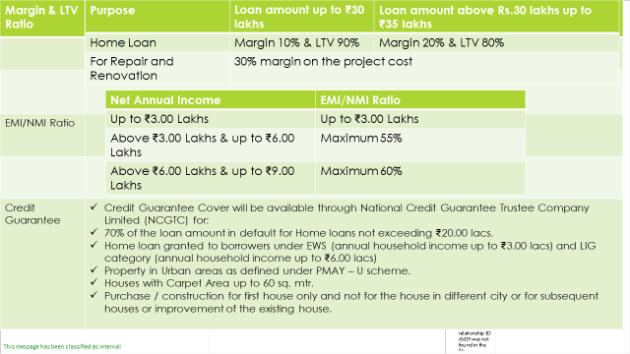

Slide 42
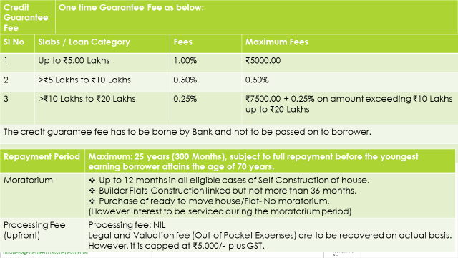

Slide 43
IB HOME LOAN PLUS
Eligibility/Target Group | All existing Home Loan borrowers (Residents & NRIs) including HL-CRE, IB Home Advantage, HL for Repairs and Renovation which are under ‘Standard’ Category. All staff members who have availed Staff Housing Loan are also eligible to avail IB Home Loan Plus provided the borrower should have paid minimum 12 EMIs regularly, possession of the house / flat has been taken by the borrower and valid mortgage has been created in favour of the Bank. Staff members / officers who have availed IB Home loan and converted to SHL are also eligible. In such cases, 12 instalments will be reckoned by including the number of EMI's paid under IBHL.
Purpose | Any confide purpose other than speculative purpose. Term Loan: Maximum tenor of 15 years. Overdraft (Step down) – OD facility will be liquidated in maximum 15 years with equal deduction every month.
Margin | Margin of 25% on Realizable Sale Value (RSV) to be maintained to arrive at Quantum of Loan.

Slide 44
IB HOME LOAN PLUS
Loan Amount | Minimum Amount – Rs. 1.00 Lakhs Maximum Amount - Rs. 1000 Lakhs
Repayment | Repayment Period - Maximum 15 years. .
Others Important Conditions | Home Loan account should not have appeared in SMA 2 during last 1 years. However, Home loan account should never have appeared in NPA.

Slide 45
IND MORTGAGE
Eligibility/Target Group | Salaried Class: Permanent Employees of Central / State Govt. / Quasi Govt. Bodies / Public Limited Companies / reputed Private Limited Companies with clear record of paying timely salaries. Applicant should have minimum completed service of 3 years. Should have / should open duly introduced account with us. Employees of Indian Bank and other Banks (PSU / Private / Foreign / Co-op) are also eligible. Others: Self employed / Professionals / Traders / Businessmen including HUF, Sole Proprietary concern, Firms and Limited companies, etc. are eligible based on their cash flow. NRI customers are also included subject to the condition that the end use is for bankable purpose, as permitted by RBI. Loan to HUF - Not permitted.
Purpose | Any purpose including repairs, renovation of buildings, marriage, education, household festivals / functions, Medical or any bankable purpose other than speculative. For Overdraft- Only for business purpose (Non Priority). In case existing limit is not in compliance with the Ind Mortgage scheme guideline, renewal may be permitted by next higher authority.

Slide 46
IND MORTGAGE
Age Group | Salaried Class: Minimum entry age: 18 years Maximum exit age: 60 years (or retirement age, whichever is earlier) ZLCC may allow relaxation up to 65 years. In cases where repayment is supported by co-applicants, the exit age may be relaxed up to 70 years, considering the retirement age of the co-applicants. P & SE / Other Individuals / Sole Proprietor: This category includes individuals with regular, verifiable income. Minimum entry age: 18 years Maximum exit age: 70 years. Pensioners: Pensioners drawing pension through the bank can access the mortgage loan up to 70 years of age, based on repayment capacity. For regular and family pensioners, branch managers can approve loans with an exit age of up to 70 years, and ZLCC can extend this up to 75 years.

Slide 47
IND MORTGAGE
Margin | 40% of the Realisable Sale Value of the immovable property offered as security - if property is situated in Tier I& II cities. 50% in case of properties situated in other places. Margin relaxation up to 5% may be permitted by ZLCC in both the cases.
Loan Amount | Individuals: – Loan quantum considering age & repayment capacity Minimum Rs.5.00 lakhs. Maximum: Rs.2500 lakhs: Other than Individuals: Loan quantum considering repayment capacity: Minimum:Rs.5.00 Lakhs Maximum: Proposals upto Rs.2500 Lakhs may be considered by field functionaries as under: RAPC can sanction upto their delegated powers. ZLCC can sanction up to their lending powers as per Chart: I-C (Secured OD /Mortgage Loan). FGMCAC can sanction upto Rs.2500 lakhs For loan amount beyond Rs. 2500 lakhs, loan will be sanctioned at Corporate office level committee upto their delegated credit powers.

Slide 48
VEHICLE LOAN SCHEME FOUR WHEELER (NEW)
Eligibility/Target Group: | Salaried class, Professionals, Businessmen, Self-employed persons including proprietorship firm, our Staffs, NRIs*, pensioners, employees of other banks with NOC from employer concerned. Minimum Service/Experience: - Sanctioning Authority may consider: - Regular employees** of Central Government / State Government / Public Sector Undertakings /Government or Government aided Educational Institutions with salary statement from the existing employer for at least previous 3 months. Regular employees** of MNC / Reputed Companies (Externally rated as BBB or above) with salary statement from the existing employer for at least previous 3-months subject to the condition that they have total experience of minimum 2 years*. ZLCC may consider total experience up to 1 Year

Slide 49
VEHICLE LOAN SCHEME FOUR WHEELER (NEW)
Eligibility/Target Group: | ZLCC may permit the following: Consider loans on selective basis to Partnership Firms, Limited companies etc. (for use by the Organization / Firm) with good repayment capacity for the use of their executive’s / Office purposes. ZLCC may consider loan for more than two Vehicles, depending on financials, security and repaying capacity. ZLCC may sanction Loan to Trust and Societies for use of vehicle for their official’s subject to compliance of other criteria and based on the provision in trust deed/society bylaws.
Quantum of Loan | Maximum loan ceiling: - Rs.500.00 Lakhs
Minimum Entry Age | 21 Years
Maximum Exit Age | Salaried class: 60 Years or till retirement Pensioner : 70 Years Others : 70 Years

Slide 50
VEHICLE LOAN SCHEME FOUR WHEELER (NEW)
Types of occupation | Eligible Amount-No. of times of Gross Income
Salaried | 48 Times of gross monthly Salary (Minimum gross monthly of Rs 25000/ and above)
Pensioner | 36 Times of gross monthly pension (Minimum gross monthly Pension of Rs 20000/ and above)
Professional & Self Employed / Businessmen | Maximum of 3 times of average Net annual income for the last two years as per latest ITR.(An IT assessee having Gross Annual Income of Rs. 3.00 lakhs above as per latest ITR. It should be ensured that ITR has been filed on regular basis (on yearly basis).)
Firms & Companies | Firms / companies should be in profit during last two years. Net Profit & cash generation during pendency of loan should be enough for repayment.

Slide 51
Waiver in obtention of collateral securities for Vehicle Loan 4-W
Authority | Loan Amount
ZLCC | Up to Rs.1.00 Crore
FGMCAC | Up to Rs.3.00 Crore
COLCC (GM) | Up to Rs.5.00 Crore
COLCC (ED) | No Limit

Slide 52
Margin for New Vehicle Loan 4 -W
10% of on road price (Ex-Showroom Price+ Road Tax+ Insurance) for New Vehicle if, | CIBIL Score 750 & above or equivalent CIC Score Or Customer is an employee of Central Govt./ State Govt./ PSUs Or Other salaried class customer with Gross Annual Income of Rs.18.00 Lakhs & above.
15 % of on road price (Ex-Showroom Price+ Road Tax+ Insurance) for New Vehicle | For other category customer
Relaxations in Margin | ZLCC may, on selective basis, relax the margin of Vehicle Loans by 5%

Slide 53
Takeover of Vehicle Loan
ZLCC may consider takeover of Vehicle loan for four wheeler from other banks selectively where:
Vehicle is not more than 2 years old.
It is a single ownership vehicle
No insurance claim has been availed and
The borrower’s account with other bank is a Standard Asset i.e., all repayments are made as per terms of sanction of the original financier. And subject to comprising our Bank’s Loan Policy guidelines.
ZLCC may also permit relaxation of take-over of vehicle loan even if the vehicle is more than 2 years old and upto 3 years old on case to case basis.
Other terms for takeover of Vehicle Loan:
Rates of interest for new Vehicles, will be applicable, if no change in ownership is envisaged
Loan to be repaid within 84 months from the date of original sale of vehicle.

Slide 54
IB VEHICLE LOAN SCHEME FOUR WHEELER(USED)
Target Group | Salaried Class, Pensioners / IB Pensioners, Businessmen, Self-employed Professionals / Non - Professionals, our Bank’s Staff, NRIs, employees of other Banks. Minimum Service / Experience other than Pensioners / IB Pensioners: 1 year [for salaried class working in Central govt., / State Govt., / PSUs / reputed companies with credit rating of A and above (for last 2 FY)] 2 Years (Other Salaried class) 2 years (for all other categories) *For NRIs (individuals only), loans for purchase of 4-wheeler (to be used by his/her family in India) may be permitted subject to the following conditions: Minimum monthly income to be Rs. 40000/- Guarantee of resident family member to be obtained (Spouse/mother/father/son/daughter) Minimum residual contract should be for 3 years .

Slide 55
IB VEHICLE LOAN SCHEME FOUR WHEELER(USED)
Minimum Entry Age | 21 Years
Maximum Exit Age | Salaried class: 60 Years or till retirement Pensioner : 70 Years Others : 65 Years
Purpose | Purchase of Used Four Wheeler Vehicles (upto second sale only); Age of vehicle not to exceed 5 years from the date of first sale.
Margin | If loan period is upto 5 years | If loan period is more than 5 years
 | The eligible loan amount will be restricted to lower of the following: 1. 80% of the Agreed Purchase Price or Market Value whichever is lower. 2. 80% of the Valuation of the vehicle / price quoted by authorized dealer like Mahindra First Choice, Maruti Suzuki True Value, Toyota U First, CarTrade, Cars24, CarWale, Spinny, Big Boy Toyz etc, Valuers registered under Automobile Association of India / Reputed Automobile Engineer / Valuer acceptable to the Bank. | The eligible loan amount will be restricted to lower of the following: 1. 70% of the Agreed Purchase Price 2. 70% of the Valuation of the vehicle / price quoted by authorized dealer like True value etc.,

Slide 56
IB VEHICLE LOAN SCHEME FOUR WHEELER(USED)
Quantum of loan | Maximum of Rs. 300.00 Lakhs per vehicle
Repayment Period | Age of Vehicle | Repayment Period
 | Upto 2 years | 72 months
 | Above 2 years upto 3 years | 60 months
 | Above 3 years upto 4 years | 48 months
 | Above 4 years upto 5 years | 36 months

Slide 57
VL SCHEME TWO WHEELER
Target Group | Salaried class, Pensioners / IB Pensioners, Businessmen, Self-employed Professionals / Non - Professionals, our Bank’s Staffs, NRIs, employees of other Banks. Customer should have SB/CA with our Bank prior to sanction of Two Wheeler Loan Minimum Service / Experience other than Pensioners / IB Pensioners: 1 Year (for salaried class working in Central govt., / State Govt., / PSUs /reputed companies with credit rating of A and above for last 2 FY) 2 Years (Other Salaried class) 2 years (for all other categories) Relaxations: ZLCC may permit the following: In case of confirmed employees of Central govt., / State Govt., / PSUs /reputed companies with credit rating of A and above (for last 2 FY), without insisting on minimum period of service / experience ZLCC can consider loan for more than One Vehicle Loan per customer, depending on financials, security and repaying capacity

Slide 58
IB VEHICLE LOAN SCHEME TWO WHEELER
Minimum entry age | 21 Years
Maximum exit age | Salaried Class: 60 Years Pensioners: 70 Years Others : 65 Years
Eligible Loan amount – per Vehicle | Maximum 75% of On Road cost. Purchase of New Two Wheeler Vehicle only
Margin | Upto 36 months’ repayment – 25% and 37 to 48 months 30% for New Vehicles. ZLCC may, on selective basis, relax the margin by 5%.
Repayment period | Maximum 48 months. No moratorium to be granted.
CIBIL | 750 and above

Slide 59
VL SCHEME TWO WHEELER
Quantum of loan | Maximum of Rs. 10.00 Lakhs per vehicle. ZLCC may permit loans upto Rs.20 Lakhs on a case to case basis.
Guarantee | Third party guarantee is to be obtained having net worth more than the loan amount for category 3 and 4 borrowers. In case full collateral security is available third party guarantee may be waived
Income eligibility | Type of Occupation | Minimum Salary/Income | Eligible Amount – Number of Times of Salary/ Income
 | Salaried Person | Minimum monthly net salary of Rs.10000/- | Maximum 48 times of Net monthly salary
 | Pensioners | Drawing monthly pension of Rs.10000/- and above. | Maximum 36 times of monthly pension.
 | Businessmen, Self-employed Professionals / Non - Professionals | An IT assesse having Net Annual Income of Rs.1.50 Lakhs and above as per latest ITR. It should be ensured that ITR has been filed on regular basis (On yearly basis). However, Net take home criteria should be minimum of 40% | Maximum of 3 times of average Net annual income for the last two years as per latest ITR.

Slide 60
IB NSC/KVP/LIC
Eligibility/Target Group | All properly introduced customers, whose capacity to service the loan and interest is appraised. (Including all Staff Members, VRS/ Retired staff. Corporate/ reputed partnership firms may also be sanctioned loan/OD against said securities under this SLP.
Purpose | For any permitted bankable purposes such as Trade, Housing, Profession, Personal consumption and educational purposes etc
Margin | Minimum 20% on Accrued/Surrender Value
Repayment | Not exceeding 5 years for NSC/KVP & 6 years LIC Policy
Security | Lien on NSC. Post Office Lien marking charges to be recovered LIC: Assignment of LIC Policy in Bank’s favour.

Slide 61
IBA Educational Loan Scheme
Category of Colleges | For studies in India, Institutes have been categorized as under: 1.Premier Elite 2. Premier Special 3. Premier 4. Others (Recognized courses of Colleges/ Universities/ Institutes not covered under the above three categories.) For Studies Abroad (except institutions in Russia, Ukraine and China) Institutes have been categorized as under: Premier Special: Institutes ranked from 1 to 1000 colleges as per latest Webometrics rankings Institutions ranked above 1000 as per latest Webometrics may be treated in Others category.

Slide 62
IBA Educational Loan Scheme
Margin | Upto Rs 4.00 lakh - NIL Above Rs.4.00 lakh to 7.5 Lakh - For studies in India 5% & for studies abroad 15% Above Rs.7.50 lakh - For studies in India 15% & for studies abroad 20% For Executive MBA Program/ Executive MBA: Margin - 25 %
Quantum of finance | For Studies in India and Abroad: Need based finance to meet expenses subject to margin requirements 5. Executive Management Program/ Executive MBA Maximum Loan Amount: Rs. 25.00 Lacs.

Slide 63
Takeover of Education Loans
Takeover of Education loans other than Premier Elite institutes is permitted on satisfaction of the following eligibility criteria.
Loan Accounts where repayment has started, the student Borrower has been placed on a suitable job, at least 12 EMI’s have been paid and accounts are regular.
Accounts are fully backed by Collateral Security. • Accounts are standard as on date of takeover and never restructured/ rephased.
For students of Premier Elite institutes, Takeover of Education loans from any Bank/ FI is permitted on satisfaction of the following eligibility criteria.
Education Loans under Premier Elite category institutes may be done anytime during the currency of the loan (which includes Course period, Moratorium & repayment period) provided the guidelines for Sanctioning Education loan in this category of institutes are complied.
Student should be Regular and Consistent in existing course/ studies.
All other existing norms for Takeover of Education loan are to be complied.

Slide 64

THANK YOU

